Slide 1
Protocol version 5.0 Training

Slide 2
Early Pregnancy Renal Anhydramnios
(EPRA)
~1/2000 pregnancies
Congenital Bilateral Renal Agenesis (CoBRA)
Early Fetal Renal Failure (FRF)
  Anhydramnios before 22 weeks gestation
    Multicystic dysplastic kidney disease
    Polycystic kidney disease
    Early severe lower urinary tract obstruction (LUTO)
O’hare et al, Fetal Diagnosis and Therapy, 2019

Slide 3
EPRA: 100% lethality from respiratory failure
Decompression of tracheobronchial tree
Compression of fetal thorax
No reported untreated survivors
Survivors will need neonatal renal replacement therapy

Slide 4

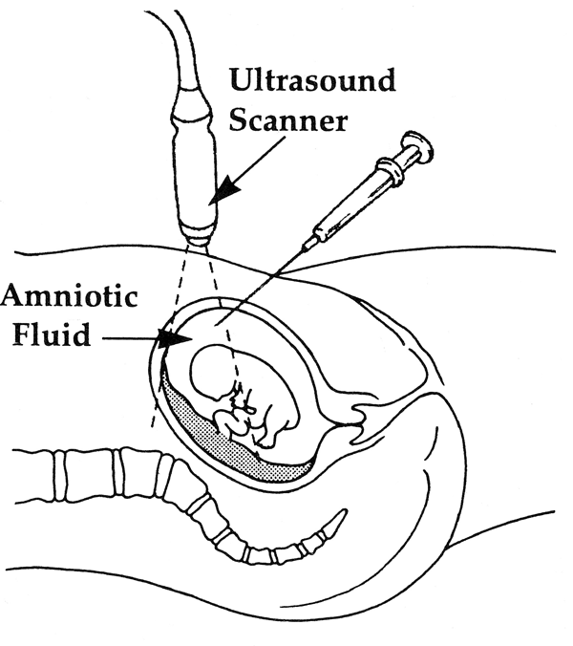
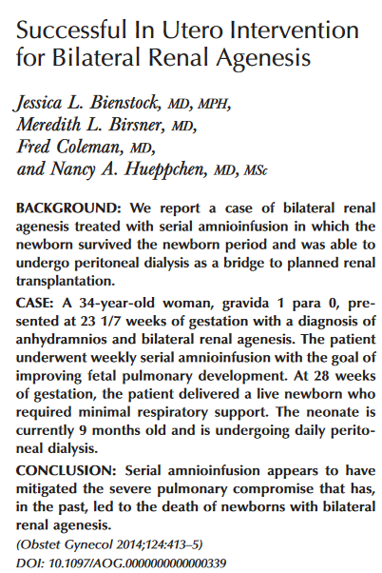
Serial amnioinfusions for CoBRA: successful case
The biologic rationale for trying this therapy was that restoration of amniotic fluid would allow repressurization of the fetal tracheal-bronchial tree to promote normal lung growth.
Notes:
The first report of succesful serial amnioinfusion to treat CoBRA was published in 2014 by Jessica Bientsock at Johns Hopkins. The biologic rationale for trying this therapy was the thought that restoration of amniotic fluid would allow repressurization of the fetal tracheal-bronchial tree to promote normal lung growth.

Slide 5
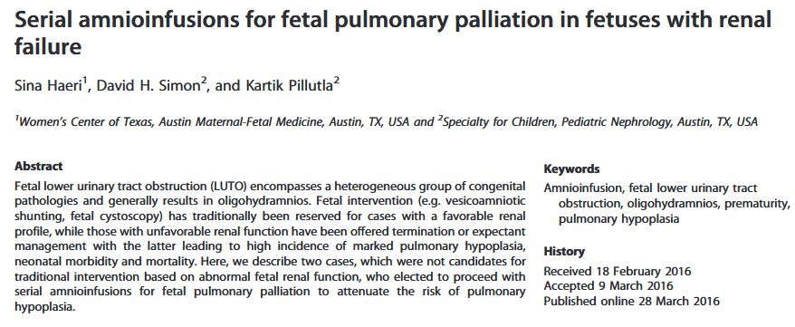

Serial amnioinfusions for Early Fetal Renal Failure (FRF): 2 successful cases

Slide 6

Notes:
This was a high profile patient who went onto receive a kidney from her father and is doing relatively well. This has led to a lot of lay interest in this therapy and several centers have begun to offer it. I think has really increased the urgency for us as a community to systematically study this therapy to determine its efficacy as well as cost before it becomes the de facto standard of care.

Slide 7
Multicenter phase trial
Aim 1: Safety and feasibility
Aim 2a: Efficacy: survival to successful dialysis
Aim 2b: Correlation between radiologic and amniotic fluid biomarkers and survival
Aim 3: long-term efficacy: survival to discharge on chronic dialysis, survival to kidney transplant, quality of life

Slide 8
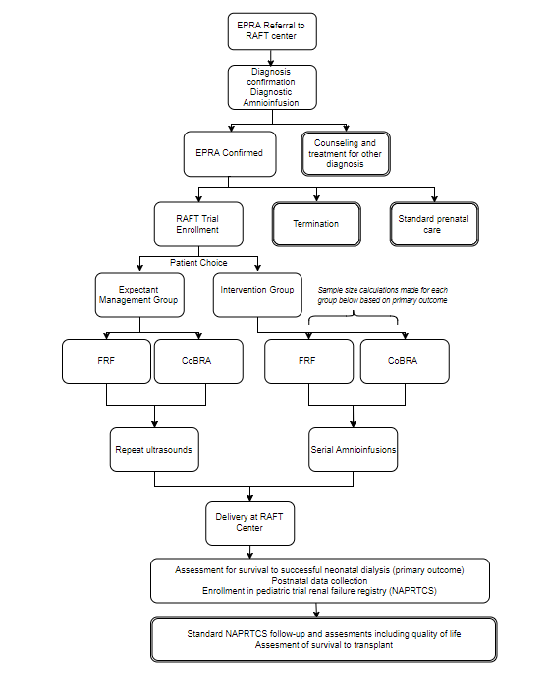

Slide 9
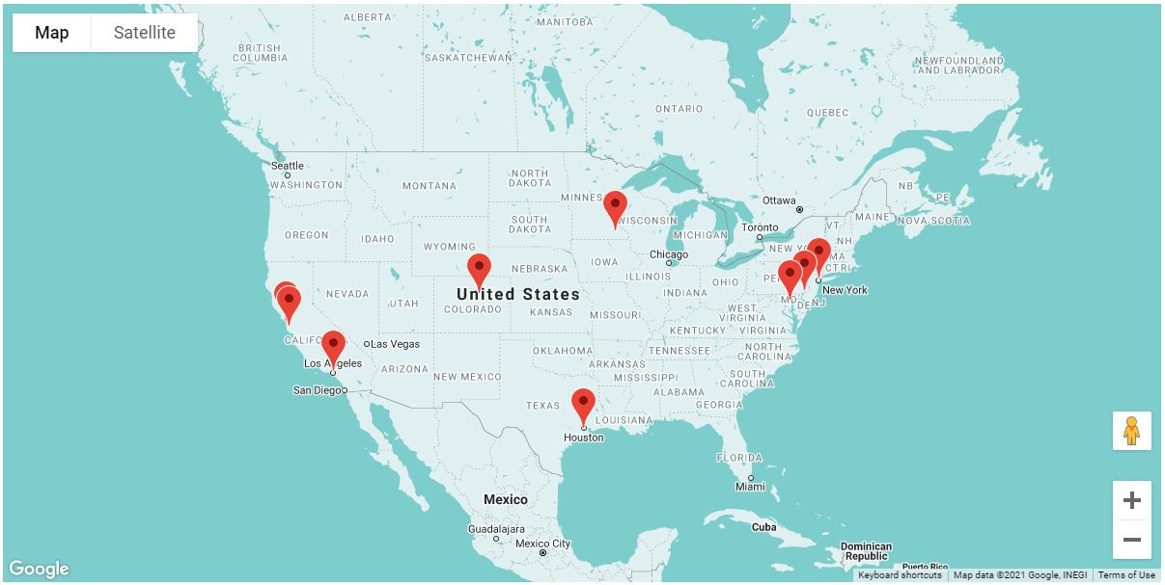











Slide 10
Trial Design
Inclusion
Exclusion
Confirmed anhydramnios before 22 wks for FRF or confirmed CoBRA
Normal karyotype
Age > 18 for expectant mothers
Willingness to be followed and deliver at RAFT center
Completed Multi-D consults
Cervix less than 2.5 cm in length
Evidence of chorioamnionitis
Other significant neuro, GI, cardiac anomalies
Evidence of rupture of membranes or separation
Abnormal Karytope or Microarry
Evidence of preterm labor
Multiple gestation pregnancy
Severe maternal medical condition in pregnancy
Technical limitations precluding amnioinfusion
BDI score ≥ 17
Notes:
We designed this as a prospective cohort trial with strict inclusion and exclusion criteria. The most important of which is that the patient have an ironclad diagnosis of CoBRA.

Slide 11
Mandatory multidisciplinary consults
MFM
Neonatology
Pediatric Nephrology
Pediatric Surgery
Transplant Surgery
Genetic Counselor
Social Work

Slide 12
Early Pregnancy Renal Anhydramnios confirmation
  Anhydramnios in the absence of ruptured membranes on U/S
Diagnostic amnioinfusion to optimize U/S
  No bladder filling; CoBRA vs FRF
Repeat imaging in 1 week
  Minimal fluid, no leakage
Notes:
This is the algorithm we use to confirm a CoBRA diagnosis

Slide 13
North American Fetal Therapy Network Endorsed: 10/2018
RAFT Consortium
RAFT Center | PI
JHU | Meredith Atkinson & Jena Miller
UCSF | Juan Gonzalez
CHOP | Julie Moldenhauer
Colorado | Mike Zaretsky
USC/CHLA | Ramen Chmait
Mayo Clinic | Rodrigo Ruano
Columbia | Russel Miller
Stanford | Yair Blumfeld

Slide 14
RAFT Enrollment Targets
Sample Size | Survival Proportion | 95% Confidence interval
32 | 0.2 | 0.055-0.355
30 | 0.3 | 0.13-0.47
33 | 0.4 | 0.23-0.57
33 | 0.5 | 0.32-0.68
31 | 0.6 | 0.42-0.78
30 | 0.7 | 0.515-0.875
25 | 0.8 | 0.615-0.975
140 maternal-fetal pairs
  Infusion intervention
    35 renal agenesis
    35 fetal renal failure
  Expectant management
    35 renal agenesis
    35 fetal renal failure

Slide 15
Intervention Group
Notes:
Those in the intervention arm are allowed to switch to expectant management arm if they do not wish to continue amnioinfusions. There are some events, should they occur, the participant would be moved into the expectant arm of the study. Uterine bleeding is an event that may or may not result in stopping the interventions.

Slide 16
Expectant
Management
Group

Slide 17
Fetal Echocardiograms
Anita Moon-Grady and Mary Donofrio will be point people → Core lab
1st before enrolled and standard of care, billed to insurance
2nd sometime after 4th amnioinfusion, paid for by study → Hyperoxia
Anita and/or Mary will lead a separate training with your designated cardiologists and coordinators

Slide 18
Fetal MRI
Dr. Aylin Tekes and Judit Machnitz will be point people
1st as standard of care and 2nd research
Lung and brain focus
Individual trainings with coordinators and designated radiologists

Slide 19
Amniotic fluid Biobanking
David Graham PhD will be point person
Will start after enrollment during first therapeutic amnioinfusion
After safe establishment of pocket, aspirate 10 ccs
  Need 15 cc tubes, centrifugation, storage and shipping capability
Process and sent to All Children’s Biorepository
Dr. Graham’s team will perform training for processing, handling and shipping

Slide 20
Following Delivery
Perinatal variables recorded after birth
  GA at delivery
  Delivery mode
  Apgar scores
  Umbilical cord blood gases
Head Ultrasound
  Required within first 7 days of life

Slide 21
Overall structure of study team

Slide 22
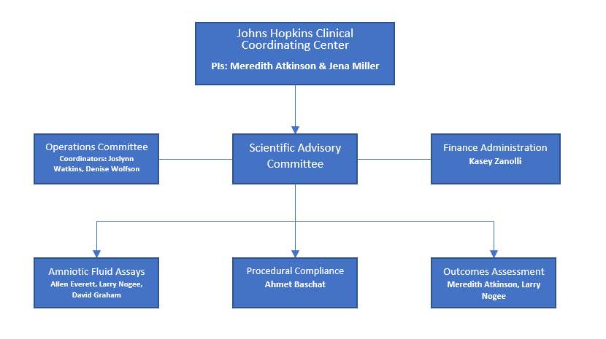
Clinical Coordinating Center (CCC)

Slide 23
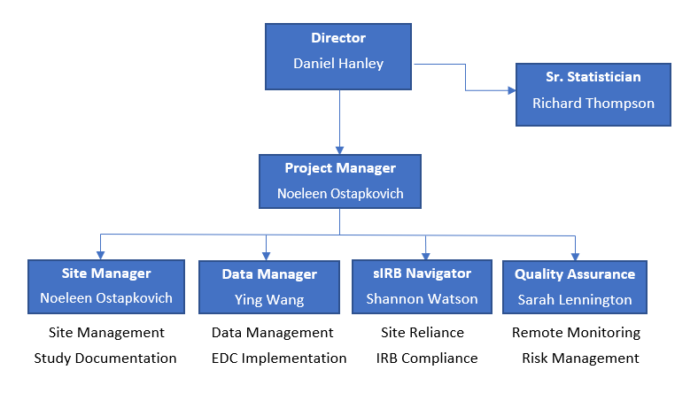
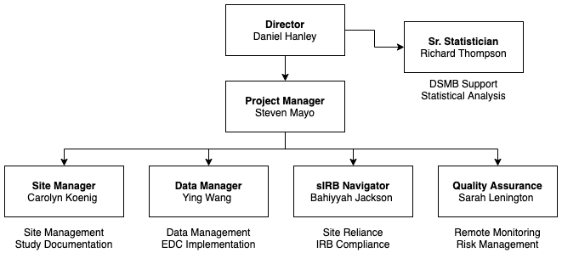
Data Coordinating Center (DCC)

Slide 24
EDC: REDCap
Ying Wang data manager
PI and coordinator training
Postnatal CRFs

Slide 25
Data Safety Monitoring Committee
DSMB
Richard Brown MD, Chairman | Director of Obstetrics and Maternal Fetal Medicine at Mcgill University Health Centre
Patricia Santiago-Munoz MD | Associate Professor of Obstetrics and Gynecology in the division of maternal-fetal medicine at UT Southwestern Medical Center
Kathryn Drennan MD | Assistant Professor of Obstetrics and Gynecology in the division of maternal fetal medicine at the University of Rochester Medical Center
Laurence McCullough PhD | Laurence McCullough, PhD Distinguished Emeritus Professor at the Baylor Center for Medical Ethics and Healthy Policy
Elizabeth Thom PhD | Research Professor of Biostatistics and Epidemiology at George Washington University

Slide 26
DSMB Convened July 2022
Standard review of maternal safety data
Included interim analysis of neonatal survival and summary of postnatal clinical courses for initial survivors

Slide 27
DSMB Recommendations- July 2022
Continue recruitment in FRF arm of trial and second interim analysis
Suspension of recruitment in BRA arm
Agree with evolving Expectant Management arm into a multi-center natural history registry
Revise consent to detail observed postnatal outcomes

Slide 28
DSMB Recommendations
Suspension of recruitment in BRA arm
  Concern for high burden of morbidity and mortality in this cohort despite high rate of achievement of primary outcome variable
  Suspend recruitment neonatal management approaches that will improve the management and outcomes of cases within this arm of the trial can be implemented

Slide 29
Long-term follow-up of RAFT participants
Neonates who are discharged home from inpatient care on chronic dialysis will require close follow-up by a pediatric nephrologist
Data on long-term outcomes for these infants, including biochemical data and quality of life indicators, will be collected for RAFT via the North American Pediatric Trials and Collaborative Studies (NAPRTCS) Registries

Slide 30

Founded in 1987
Includes information from 21,000+ children with kidney disease from > 100 participating centers in the U.S., Canada, Mexico and Costa Rica
Collects information on children at all stages of kidney disease: chronic kidney disease to dialysis and transplant
Clinical trials network for both NIH- and industry-sponsored trials
NAPRTCS.ORG

Slide 31
Pediatric data
North American Pediatric Renal Trials Collaborative (NAPRTCS)
  Survival to transplant
  Time to transplant
  Number of hospitalizations prior to transplant
  Need for urinary tract reconstruction
PEDs QLTM Pediatric Measurement Model for the Pediatric Quality of Life Inventory ScoresTM
Notes:
We have partnered with the largest US national pediatric renal failure registry, NAPRTCS, to follow survivors longitudinally and measure clinical as well as quality of life and cost variables.

Slide 32
NAPRTCS
Participants will be enrolled at a pediatric nephrology center where they receive outpatient care
Data will be collected every 6 months including
  Dialysis modality, modality changes, dialysis-associated infections, hospitalizations, mortality
  Laboratory data
  Transplant information
  Family/caregiver reported quality of life
NAPRTCS.ORG

Slide 33
Long-term follow-up of RAFT participants
The process to ensure long term follow up with these neonates through NAPRTCS will be reviewed with site coordinators during your weekly calls with your Site Manager

Slide 34
Consent Training for RAFT Team
This is a separate training that will be offered by an on-line training module.
You can complete it at anytime from your computer.
Your site manager will review the training process with you during the weekly startup ZOOM meetings.

