Slide 1

RAFT Monthly All-Sites
May 22, 2023, 10-11am EST

Slide 2
Agenda
Interim plan for CoBRA patients
Enrollment report
Manuscript Update
Reminders about next All-Sites meeting (6/26)
Open Discussion

Slide 3
RAFT Trial Timeline
NICHD
funding
March 2021-February 2022
March 2023-February 2024
We are here
March 2020-February 2021
March 2022- February 2023
March 2024-February 2025
All 9 sites activated as of August 2021

Slide 4
Enrollment Report

Slide 5
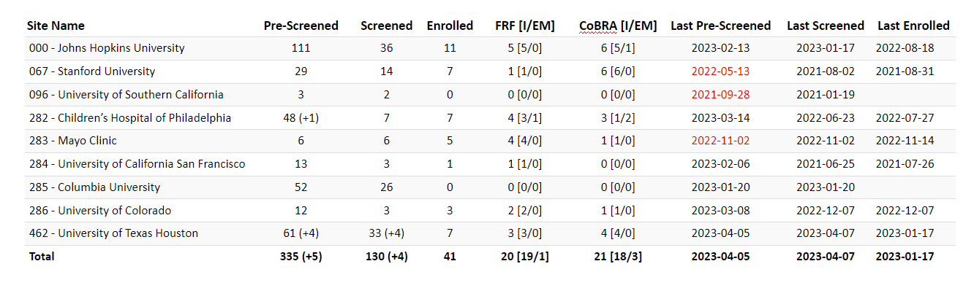
RAFT Prescreen, Screen & Enrollment Report
Data is as of April 11, 2023
Numbers in parentheses indicate changes since last report date March 13, 2023
* USC enrolled one participant, who is transferred to Stanford.

Slide 6
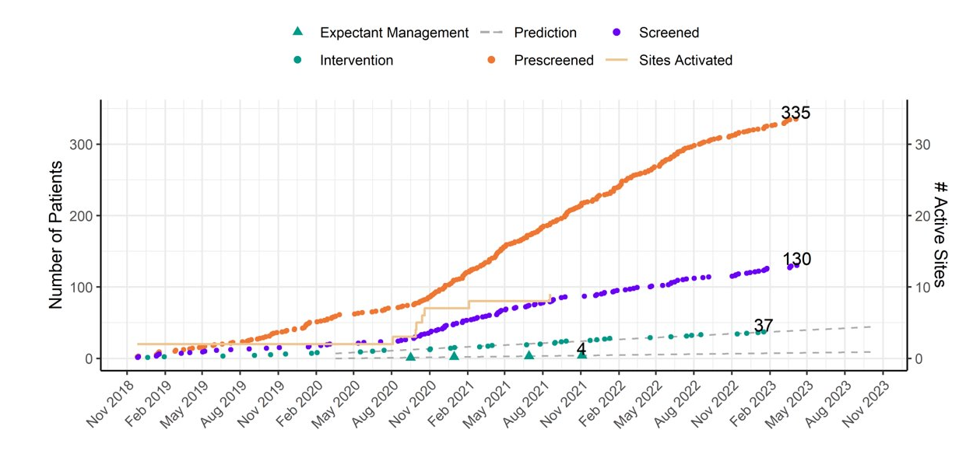
RAFT Prescreen, Screening and Enrollment Over Time

Slide 7
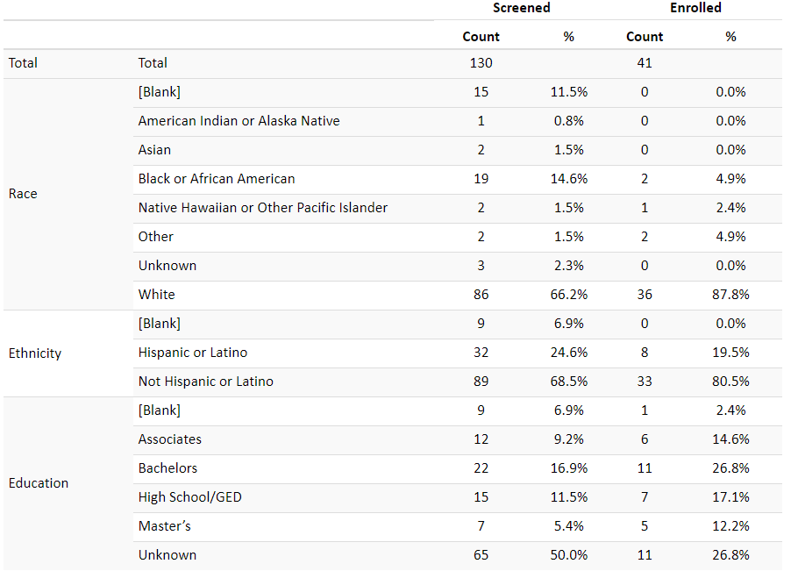
Demographics

Slide 8
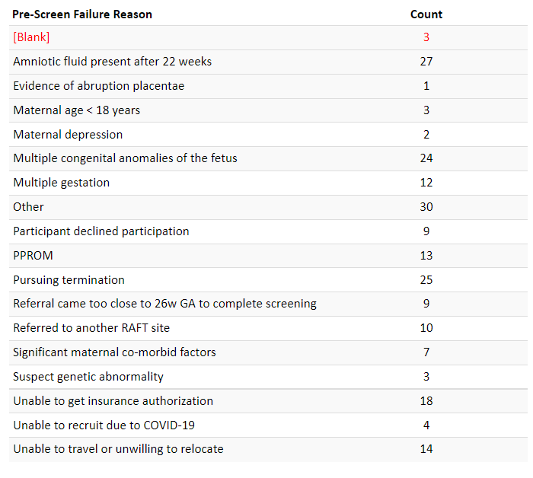
Pre-Screen Failure Primary Reasons

Slide 9
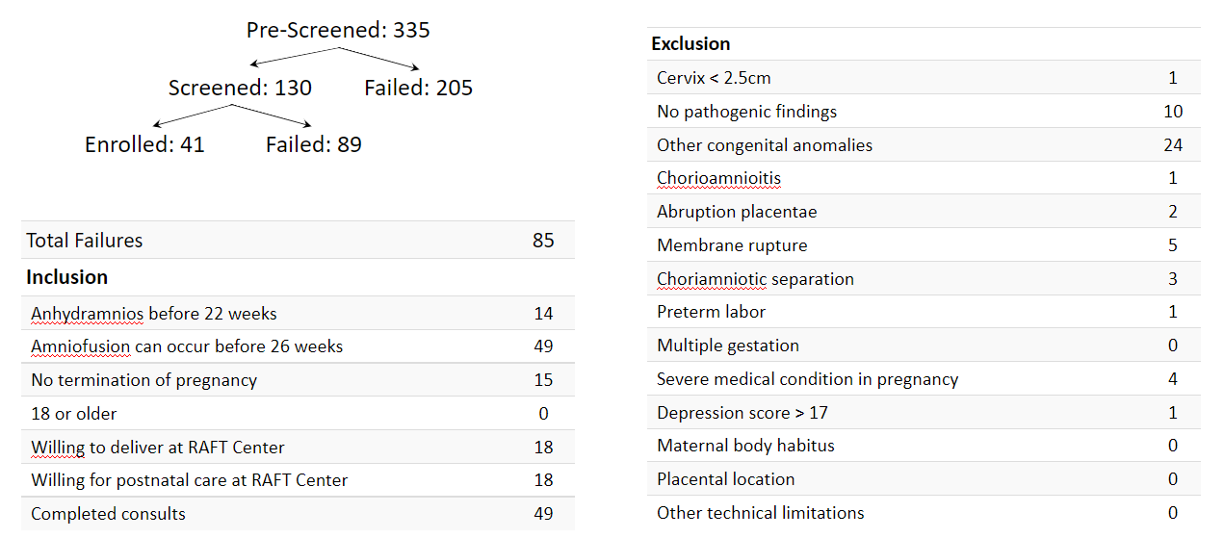
Screen Failure

Slide 10
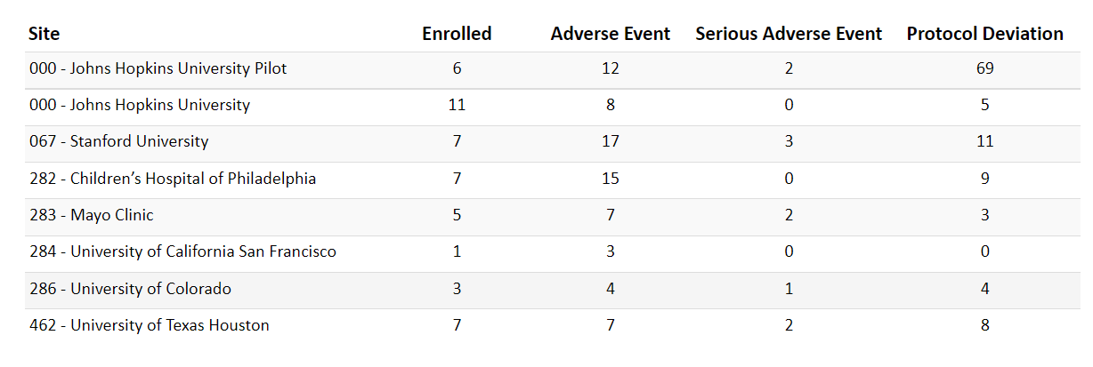
Protocol Deviations and Adverse Events

Slide 11
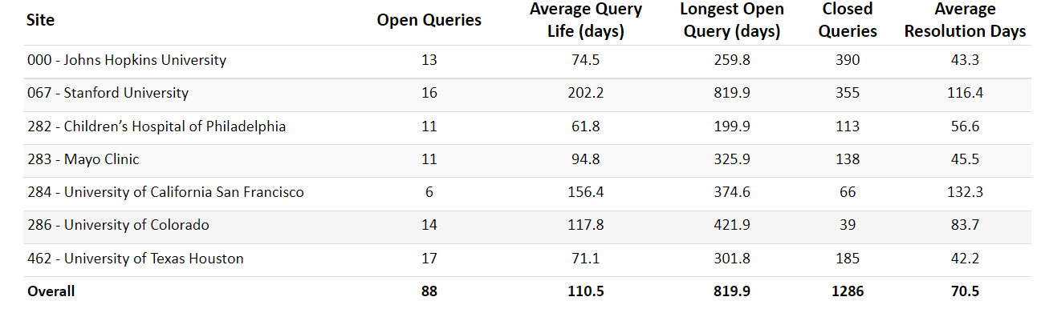
Queries

Slide 12
Sample Shipment Update
Current list of Sites that have sent samples to biorepository
  Johns Hopkins
  USC
  Mayo
SITE | PARTICIPANT ID
RAFT-JHM | 000-10
RAFT-JHM | 000-11
RAFT-JHM | RAFT-008
RAFT-LAFS | 9601
RAFT-MAYO | 283-01
RAFT-MAYO | 283-03
RAFT-MAYO | 283-04

Slide 13
Manuscript Update

Slide 14
Questions?

