Slide 1
RAFT Monthly All-Sites
December 19, 2022, 10-11 am EST

Slide 2
Agenda
DSMB Meeting Recap
Ethics Consult Recap
Enrollment report
Abstract/Manuscript Update
Biorepository Tubes/Kits
Rescheduling Jan & Feb Meetings (Holidays)
Open Discussion

Slide 3
RAFT Trial Timeline
NICHD
funding
We are here
March 2021-February 2022
March 2023-February 2024
March 2020-February 2021
March 2022- February 2023
March 2024-February 2025
All 9 sites activated as of August 2021

Slide 4
DSMB Meeting Recap
Discussion

Slide 5
Ethics Consult Recap
Discussion

Slide 6
Enrollment Report

Slide 7
RAFT Prescreen, Screen & Enrollment Report
Data is as of December 16, 2022
Numbers in parentheses indicate changes since last report date November 14, 2022
Site Name​ | Pre-Screened​ | Screened​ | Enrolled​ | FRF [I/EM]​ | CoBRA [I/EM]​ | Last Pre-Screened​ | Last Screened​ | Last Enrolled​
000 - Johns Hopkins University​ | 109 (+1)​ | 35​ | 11​ | 5 [5/0]​ | 6 [5/1]​ | 2022-11-18​ | 2022-09-06​ | 2022-08-18​
067 - Stanford University​ | 29​ | 14​ | 7​ | 1 [1/0]​ | 6 [6/0]​ | 2022-05-13​ | 2021-08-02​ | 2021-08-31​
096 - University of Southern California​ | 3​ | 2​ | 0​ | 0 [0/0]​ | 0 [0/0]​ | 2021-09-28​ | 2021-01-19​ | ​
282 - Children’s Hospital of Philadelphia​ | 44​ | 7​ | 7​ | 4 [3/1]​ | 3 [1/2]​ | 2022-10-26​ | 2022-06-23​ | 2022-07-27​
283 - Mayo Clinic​ | 6​ | 6​ | 5 (+1)​ | 3 [3/0]​ | 2 [2/0]​ | 2022-11-02​ | 2022-11-02​ | 2022-11-14​
284 - University of California San Francisco​ | 12​ | 3​ | 1​ | 1 [1/0]​ | 0 [0/0]​ | 2022-10-03​ | 2021-06-25​ | 2021-07-26​
285 - Columbia University​ | 50 (+1)​ | 24 (+1)​ | 0​ | 0 [0/0]​ | 0 [0/0]​ | 2022-11-17​ | 2022-11-17​ | ​
286 - University of Colorado​ | 10​ | 2​ | 2​ | 0 [0/0]​ | 2 [2/0]​ | 2022-06-06​ | 2021-12-28​ | 2021-12-29​
462 - University of Texas Houston​ | 53​ | 25​ | 5​ | 1 [1/0]​ | 4 [4/0]​ | 2022-09-12​ | 2022-08-23​ | 2022-01-10​
Total​ | 316 (+2)​ | 118 (+1)​ | 38 (+1)​ | 15 [14/1]​ | 23 [20/3]​ | 2022-11-18​ | 2022-11-17​ | 2022-11-14​
* USC enrolled one participant, who is transferred to Stanford.

Slide 8
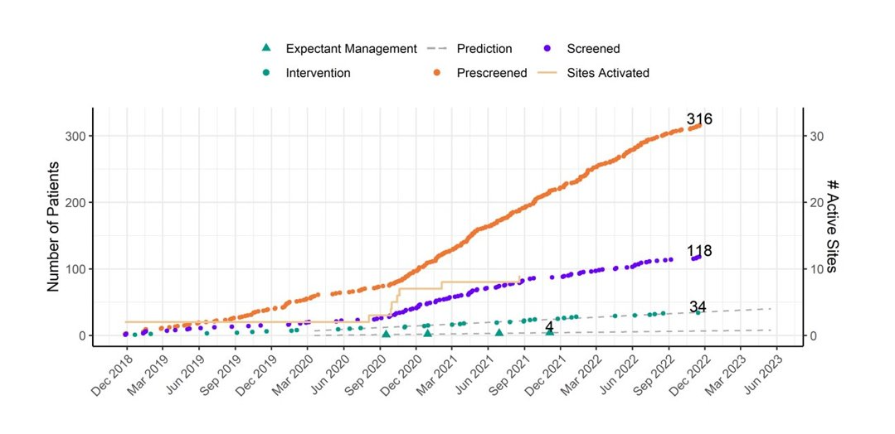
RAFT Prescreen, Screening and Enrollment Over Time

Slide 9
Demographics
​ | ​ | Screened​ |  | Enrolled​
​ | ​ | Count​ | %​ | Count​ | %​
Total​ | Total​ | 118​ | ​ | 38​ | ​
Race​ | [Blank]​ | 13​ | 11.0%​ | 0​ | 0.0%​
 | American Indian or Alaska Native​ | 1​ | 0.8%​ | 0​ | 0.0%​
 | Asian​ | 2​ | 1.7%​ | 0​ | 0.0%​
 | Black or African American​ | 15​ | 12.7%​ | 1​ | 2.6%​
 | Native Hawaiian or Other Pacific Islander​ | 2​ | 1.7%​ | 1​ | 2.6%​
 | Other​ | 1​ | 0.8%​ | 1​ | 2.6%​
 | Unknown​ | 2​ | 1.7%​ | 0​ | 0.0%​
 | White​ | 82​ | 69.5%​ | 35​ | 92.1%​
Ethnicity​ | [Blank]​ | 7​ | 5.9%​ | 0​ | 0.0%​
 | Hispanic or Latino​ | 30​ | 25.4%​ | 7​ | 18.4%​
 | Not Hispanic or Latino​ | 81​ | 68.6%​ | 31​ | 81.6%​
Education​ | [Blank]​ | 7​ | 5.9%​ | 1​ | 2.6%​
 | Associates​ | 11​ | 9.3%​ | 5​ | 13.2%​
 | Bachelors​ | 21​ | 17.8%​ | 10​ | 26.3%​
 | High School/GED​ | 14​ | 11.9%​ | 7​ | 18.4%​
 | Master’s​ | 7​ | 5.9%​ | 5​ | 13.2%​
 | Unknown​ | 58​ | 49.2%​ | 10​ | 26.3%​

Slide 10
Pre-Screen Failure Primary Reasons
Pre-Screen Failure Reason​ | Count​
[Blank]​ | 3​
Amniotic fluid present after 22 weeks​ | 26​
Evidence of abruption placentae​ | 1​
Maternal age < 18 years​ | 3​
Maternal depression​ | 2​
Multiple congenital anomalies of the fetus​ | 23​
Multiple gestation​ | 11​
Other​ | 29​
Participant declined participation​ | 8​
PPROM​ | 13​
Pursuing termination​ | 25​
Referral came too close to 26w GA to complete screening​ | 7​
Referred to another RAFT site​ | 10​
Significant maternal co-morbid factors​ | 7​
Suspect genetic abnormality​ | 3​
Unable to get insurance authorization​ | 18​
Unable to recruit due to COVID-19​ | 4​
Unable to travel or unwilling to relocate​ | 14​

Slide 11
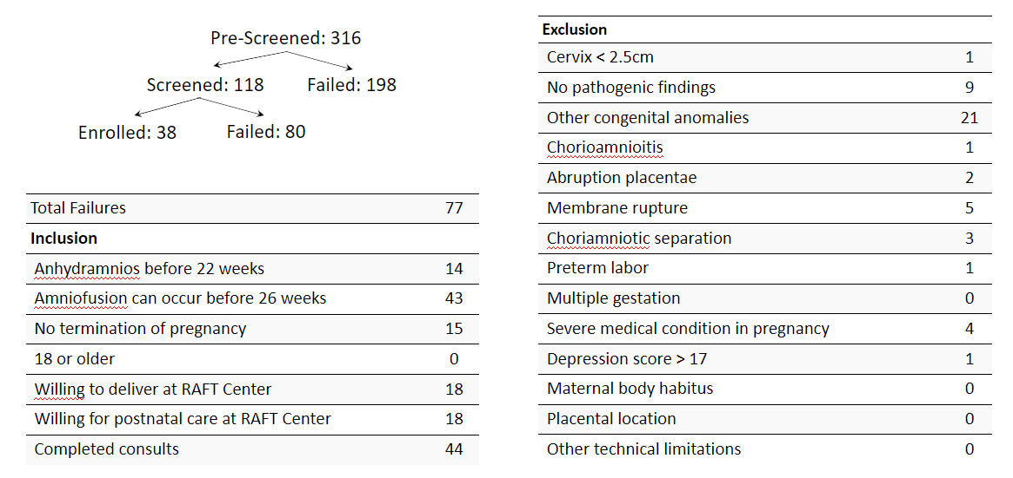
Screen Failure

Slide 12
Protocol Deviations and Adverse Events
Site​ | Enrolled​ | Adverse Event​ | Serious Adverse Event​ | Protocol Deviation​
000 - Johns Hopkins University Pilot​ | 6​ | 12​ | 2​ | 61​
000 - Johns Hopkins University​ | 11​ | 8​ | 0​ | 4​
067 - Stanford University​ | 7​ | 17​ | 3​ | 11​
282 - Children’s Hospital of Philadelphia​ | 7​ | 15​ | 0​ | 9​
283 - Mayo Clinic​ | 5​ | 5​ | 1​ | 3​
284 - University of California San Francisco​ | 1​ | 3​ | 0​ | 0​
286 - University of Colorado​ | 2​ | 3​ | 1​ | 2​
462 - University of Texas Houston​ | 5​ | 6​ | 1​ | 6​

Slide 13
Queries
Site​ | Open Queries​ | Average Query​ Life (days)​ | Longest Open Query (days)​ | Closed Queries​ | Average Resolution Days​
000 - Johns Hopkins University​ | 6​ | 62.1​ | 143.8​ | 353​ | 46.1​
067 - Stanford University​ | 13​ | 136.8​ | 703.9​ | 332​ | 119.4​
282 - Children’s Hospital of Philadelphia​ | 4​ | 63​ | 83.9​ | 98​ | 48.3​
283 - Mayo Clinic​ | 8​ | 169.1​ | 291​ | 112​ | 39.6​
284 - University of California San Francisco​ | 3​ | 151.2​ | 258.7​ | 65​ | 131.6​
286 - University of Colorado​ | 6​ | 120.5​ | 185.9​ | 23​ | 86.3​
462 - University of Texas Houston​ | 3​ | 160.6​ | 185.9​ | 169​ | 44.5​
Overall​ | 43​ | 125.9​ | 703.9​ | 1152​ | 72.2​

Slide 14
Abstract/Manuscript Update
Submitted Late-breaking abstract with 20 BRA participant data for SMFM meeting 2023
Accepted for SMFM meeting in Feb
Draft Manuscript

Slide 15
Biorepository Tubes/Kits
Update to Tracking Form
One kit / timepoint

Slide 16
Rescheduling Meetings
January and February PI Meetings currently fall on Holidays

Slide 17
Questions?

