Slide 1

RAFT Monthly All-Sites
February 27, 2023, 10-11am EST

Slide 2
Agenda
Enrollment report
DSMB Communication
Protocol Pre-screen/Screen Criteria
New Enrollment Plan
Manuscript Update

Slide 3
RAFT Trial Timeline
NICHD
funding
We are here
March 2021-February 2022
March 2023-February 2024
March 2020-February 2021
March 2022- February 2023
March 2024-February 2025
All 9 sites activated as of August 2021

Slide 4
Enrollment Report

Slide 5
RAFT Prescreen, Screen & Enrollment Report
Data is as of February 20, 2023
Numbers in parentheses indicate changes since last report date January 30, 2023
Site Name​ | Pre-Screened​ | Screened​ | Enrolled​ | FRF [I/EM]​ | CoBRA [I/EM]​ | Last Pre-Screened​ | Last Screened​ | Last Enrolled​
000 - Johns Hopkins University​ | 110​ | 36​ | 11​ | 5 [5/0]​ | 6 [5/1]​ | 2023-01-17​ | 2023-01-17​ | 2022-08-18​
067 - Stanford University​ | 29​ | 14​ | 7​ | 1 [1/0]​ | 6 [6/0]​ | 2022-05-13​ | 2021-08-02​ | 2021-08-31​
096 - University of Southern California​ | 3​ | 2​ | 0​ | 0 [0/0]​ | 0 [0/0]​ | 2021-09-28​ | 2021-01-19​ | ​
282 - Children’s Hospital of Philadelphia​ | 45​ | 7​ | 7​ | 4 [3/1]​ | 3 [1/2]​ | 2022-12-23​ | 2022-06-23​ | 2022-07-27​
283 - Mayo Clinic​ | 6​ | 6​ | 5​ | 4 [4/0]​ | 1 [1/0]​ | 2022-11-02​ | 2022-11-02​ | 2022-11-14​
284 - University of California San Francisco​ | 13 (+1)​ | 3​ | 1​ | 1 [1/0]​ | 0 [0/0]​ | 2023-02-06​ | 2021-06-25​ | 2021-07-26​
285 - Columbia University​ | 52​ | 26​ | 0​ | 0 [0/0]​ | 0 [0/0]​ | 2023-01-20​ | 2023-01-20​ | ​
286 - University of Colorado​ | 11​ | 3​ | 3​ | 2 [2/0]​ | 1 [1/0]​ | 2022-11-30​ | 2022-12-07​ | 2022-12-07​
462 - University of Texas Houston​ | 55​ | 27​ | 7​ | 3 [3/0]​ | 4 [4/0]​ | 2023-01-03​ | 2023-01-05​ | 2023-01-17​
Total​ | 324 (+1)​ | 124​ | 41​ | 20 [19/1]​ | 21 [18/3]​ | 2023-02-06​ | 2023-01-20​ | 2023-01-17​
* USC enrolled one participant, who is transferred to Stanford.
Notes:
Does not include one recent enrollment from Colorado and one recent enrollment from Texas
JHU screenings ongoing

Slide 6
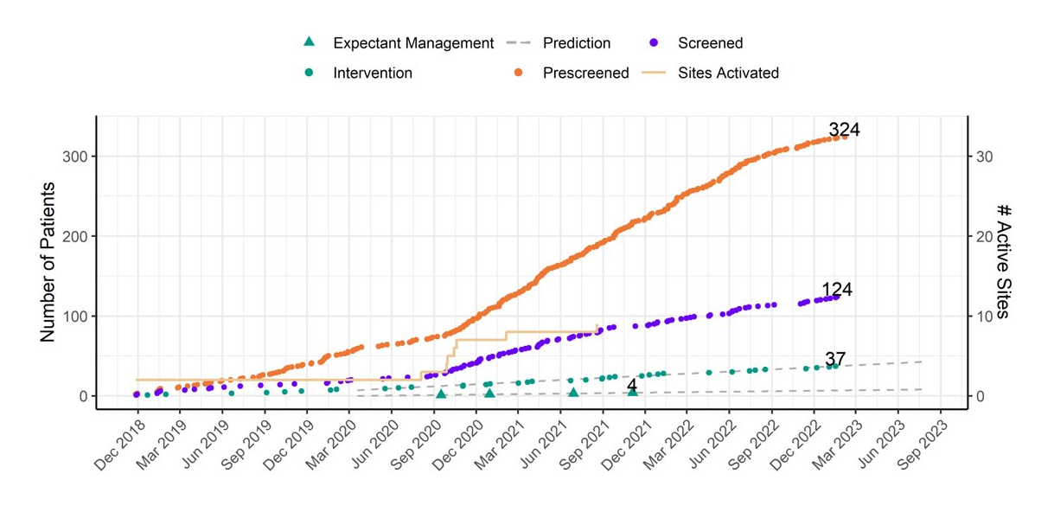
RAFT Prescreen, Screening and Enrollment Over Time
Notes:
Need chart

Slide 7
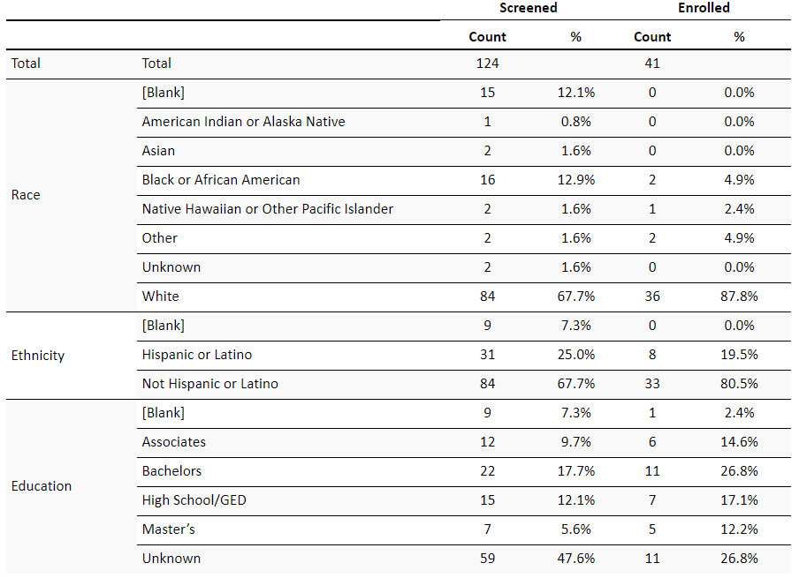
Demographics

Slide 8
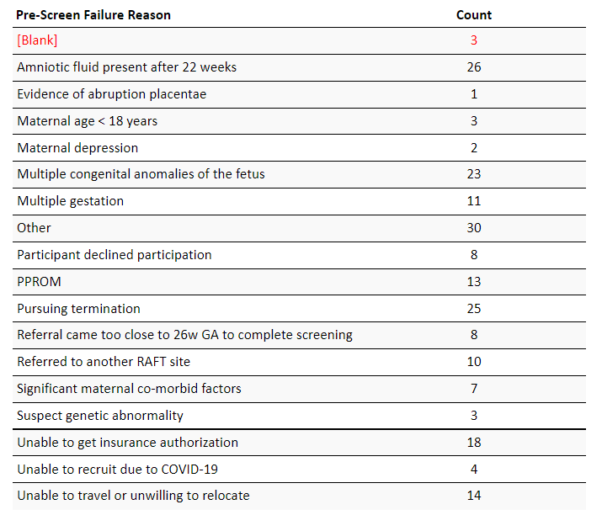
Pre-Screen Failure Primary Reasons

Slide 9
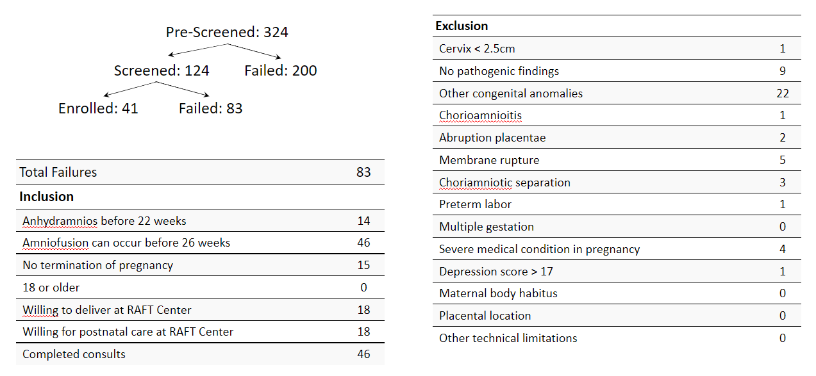
Screen Failure
Notes:
Start with this slide

Slide 10
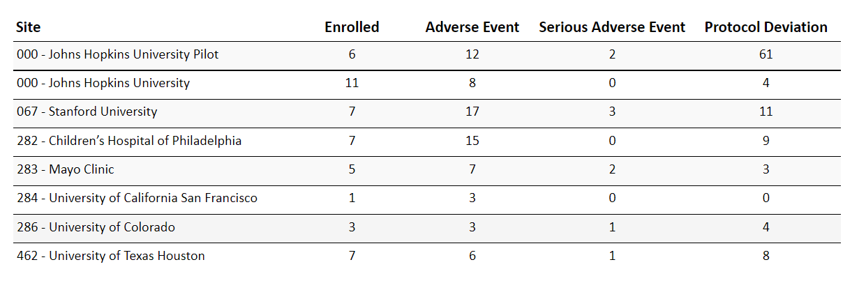
Protocol Deviations and Adverse Events

Slide 11
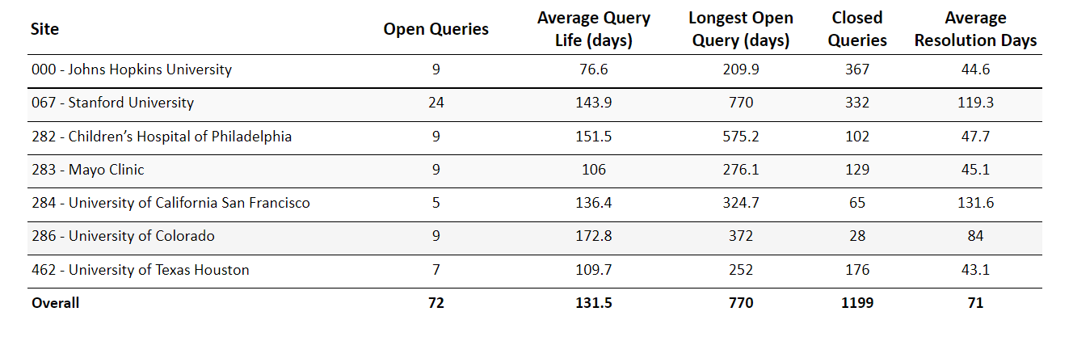
Queries

Slide 12
DSMB Communication

Slide 13
Protocol Pre-screen/Screen Criteria

Slide 14
New Enrollment Plan

Slide 15
Manuscript Update

Slide 16
Questions?

