Slide 1

RAFT Monthly All-Sites
January 23, 2023, 11-12 pm EST

Slide 2
Agenda
Enrollment report
Biorepository Tubes/Kits
SMFM Conference Abstract Slides

Slide 3
RAFT Trial Timeline
NICHD
funding
We are here
March 2021-February 2022
March 2023-February 2024
March 2020-February 2021
March 2022- February 2023
March 2024-February 2025
All 9 sites activated as of August 2021

Slide 4
Enrollment Report

Slide 5
RAFT Prescreen, Screen & Enrollment Report
Data is as of January 17, 2023
Numbers in parentheses indicate changes since last report date December 16, 2022
Site Name​ | Pre-Screened​ | Screened​ | Enrolled​ | FRF [I/EM]​ | CoBRA [I/EM]​ | Last Pre-Screened​ | Last Screened​ | Last Enrolled​
000 - Johns Hopkins University​ | 109​ | 35​ | 11​ | 5 [5/0]​ | 6 [5/1]​ | 2022-11-18​ | 2022-09-06​ | 2022-08-18​
067 - Stanford University​ | 29​ | 14​ | 7​ | 1 [1/0]​ | 6 [6/0]​ | 2022-05-13​ | 2021-08-02​ | 2021-08-31​
096 - University of Southern California​ | 3​ | 2​ | 0​ | 0 [0/0]​ | 0 [0/0]​ | 2021-09-28​ | 2021-01-19​ | ​
282 - Children’s Hospital of Philadelphia​ | 44​ | 7​ | 7​ | 4 [3/1]​ | 3 [1/2]​ | 2022-10-26​ | 2022-06-23​ | 2022-07-27​
283 - Mayo Clinic​ | 6​ | 6​ | 5​ | 3 [3/0]​ | 2 [2/0]​ | 2022-11-02​ | 2022-11-02​ | 2022-11-14​
284 - University of California San Francisco​ | 12​ | 3​ | 1​ | 1 [1/0]​ | 0 [0/0]​ | 2022-10-03​ | 2021-06-25​ | 2021-07-26​
285 - Columbia University​ | 51​ | 24​ | 0​ | 0 [0/0]​ | 0 [0/0]​ | 2022-12-08​ | 2022-11-17​ | ​
286 - University of Colorado​ | 10​ | 2​ | 2​ | 0 [0/0]​ | 2 [2/0]​ | 2022-06-06​ | 2021-12-28​ | 2021-12-29​
462 - University of Texas Houston​ | 54​ | 26 (+1)​ | 6 (+1)​ | 2 [2/0]​ | 4 [4/0]​ | 2022-12-13​ | 2022-12-27​ | 2023-01-03​
Total​ | 318​ | 119 (+1)​ | 39 (+1)​ | 16 [15/1]​ | 23 [20/3]​ | 2022-12-13​ | 2022-12-27​ | 2023-01-03​
* USC enrolled one participant, who is transferred to Stanford.
Notes:
Does not include one recent enrollment from Colorado and one recent enrollment from Texas
JHU screenings ongoing

Slide 6
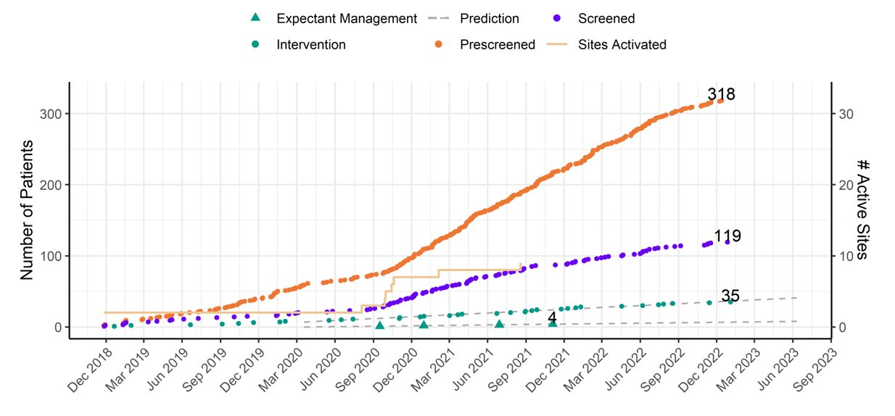
RAFT Prescreen, Screening and Enrollment Over Time
Notes:
Need chart

Slide 7
Demographics
​ | ​ | Screened​ |  | Enrolled​
​ | ​ | Count​ | %​ | Count​ | %​
Total​ | Total​ | 119​ | ​ | 39​ | ​
Race​ | [Blank]​ | 13​ | 10.9%​ | 0​ | 0.0%​
 | American Indian or Alaska Native​ | 1​ | 0.8%​ | 0​ | 0.0%​
 | Asian​ | 2​ | 1.7%​ | 0​ | 0.0%​
 | Black or African American​ | 15​ | 12.6%​ | 1​ | 2.6%​
 | Native Hawaiian or Other Pacific Islander​ | 2​ | 1.7%​ | 1​ | 2.6%​
 | Other​ | 1​ | 0.8%​ | 1​ | 2.6%​
 | Unknown​ | 2​ | 1.7%​ | 0​ | 0.0%​
 | White​ | 83​ | 69.7%​ | 36​ | 92.3%​
Ethnicity​ | [Blank]​ | 7​ | 5.9%​ | 0​ | 0.0%​
 | Hispanic or Latino​ | 30​ | 25.2%​ | 7​ | 17.9%​
 | Not Hispanic or Latino​ | 82​ | 68.9%​ | 32​ | 82.1%​
Education​ | [Blank]​ | 7​ | 5.9%​ | 1​ | 2.6%​
 | Associates​ | 11​ | 9.2%​ | 5​ | 12.8%​
 | Bachelors​ | 22​ | 18.5%​ | 11​ | 28.2%​
 | High School/GED​ | 14​ | 11.8%​ | 7​ | 17.9%​
 | Master’s​ | 7​ | 5.9%​ | 5​ | 12.8%​
 | Unknown​ | 58​ | 48.7%​ | 10​ | 25.6%​

Slide 8
Pre-Screen Failure Primary Reasons
Pre-Screen Failure Reason​ | Count​
[Blank]​ | 3​
Amniotic fluid present after 22 weeks​ | 26​
Evidence of abruption placentae​ | 1​
Maternal age < 18 years​ | 3​
Maternal depression​ | 2​
Multiple congenital anomalies of the fetus​ | 23​
Multiple gestation​ | 11​
Other​ | 29​
Participant declined participation​ | 8​
PPROM​ | 13​
Pursuing termination​ | 25​
Referral came too close to 26w GA to complete screening​ | 7​
Referred to another RAFT site​ | 10​
Significant maternal co-morbid factors​ | 7​
Suspect genetic abnormality​ | 3​
Unable to get insurance authorization​ | 18​
Unable to recruit due to COVID-19​ | 4​
Unable to travel or unwilling to relocate​ | 14​

Slide 9
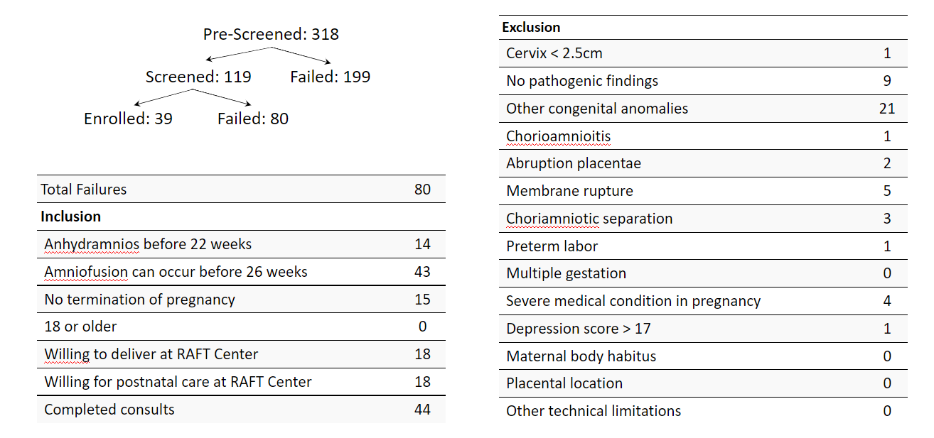
Screen Failure
Notes:
Start with this slide

Slide 10
Protocol Deviations and Adverse Events
Site​ | Enrolled​ | Adverse Event​ | Serious Adverse Event​ | Protocol Deviation​
000 - Johns Hopkins University Pilot​ | 6​ | 12​ | 2​ | 61​
000 - Johns Hopkins University​ | 11​ | 8​ | 0​ | 4​
067 - Stanford University​ | 7​ | 17​ | 3​ | 11​
282 - Children’s Hospital of Philadelphia​ | 7​ | 15​ | 0​ | 9​
283 - Mayo Clinic​ | 5​ | 7​ | 2​ | 3​
284 - University of California San Francisco​ | 1​ | 3​ | 0​ | 0​
286 - University of Colorado​ | 2​ | 3​ | 1​ | 2​
462 - University of Texas Houston​ | 6​ | 6​ | 1​ | 6​

Slide 11
Queries
Site​ | Open Queries​ | Average Query​ Life (days)​ | Longest Open Query (days)​ | Closed Queries​ | Average Resolution Days​
000 - Johns Hopkins University​ | 6​ | 87.3​ | 175.9​ | 355​ | 45.9​
067 - Stanford University​ | 13​ | 168.9​ | 736​ | 332​ | 119.4​
282 - Children’s Hospital of Philadelphia​ | 4​ | 95​ | 115.9​ | 98​ | 48.3​
283 - Mayo Clinic​ | 9​ | 171.2​ | 323​ | 119​ | 38.1​
284 - University of California San Francisco​ | 3​ | 183.2​ | 290.7​ | 65​ | 131.6​
286 - University of Colorado​ | 6​ | 152.5​ | 217.9​ | 23​ | 86.3​
462 - University of Texas Houston​ | 3​ | 192.6​ | 217.9​ | 169​ | 44.5​
Overall​ | 44​ | 151.9​ | 736​ | 1161​ | 71.7​

Slide 12
Biorepository Tubes/Kits
Update to Tracking Form
One kit / timepoint
Lab Manual Updated

Slide 13
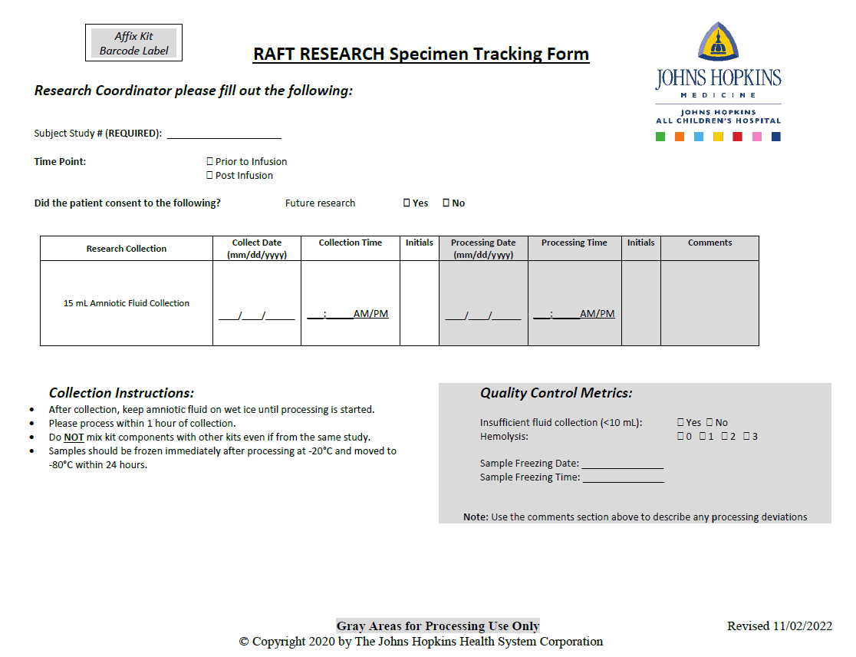
New Specimen Tracking Form

Slide 14
SMFM Conf Slides

Slide 15
Questions?

