Slide 1
RAFT Monthly All-Sites
September 18, 2023, 10-11am EST

Slide 2
Agenda
Enrollment report
New Sites Update
Registry Progress
CoBRA Manuscript
NAFTNet 2023 Agenda

Slide 3
RAFT Trial Timeline
NICHD
funding
March 2021-February 2022
March 2023-February 2024
We are here
March 2020-February 2021
March 2022- February 2023
March 2024-February 2025
All 9 sites activated as of August 2021

Slide 4
Enrollment Report

Slide 5
RAFT Prescreen, Screen & Enrollment Report
Data is as of September 12, 2023
Numbers in parentheses indicate changes since last report date August 15, 2023
* USC enrolled one participant, who is transferred to Stanford.

Slide 6
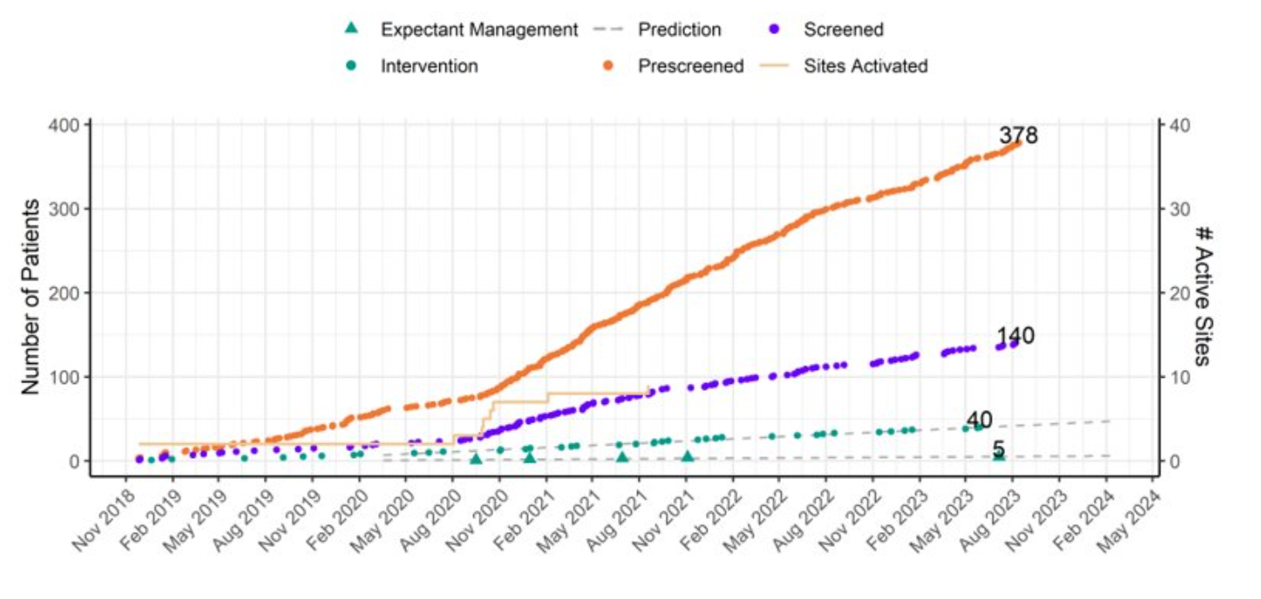
RAFT Prescreen, Screening and Enrollment Over Time

Slide 7
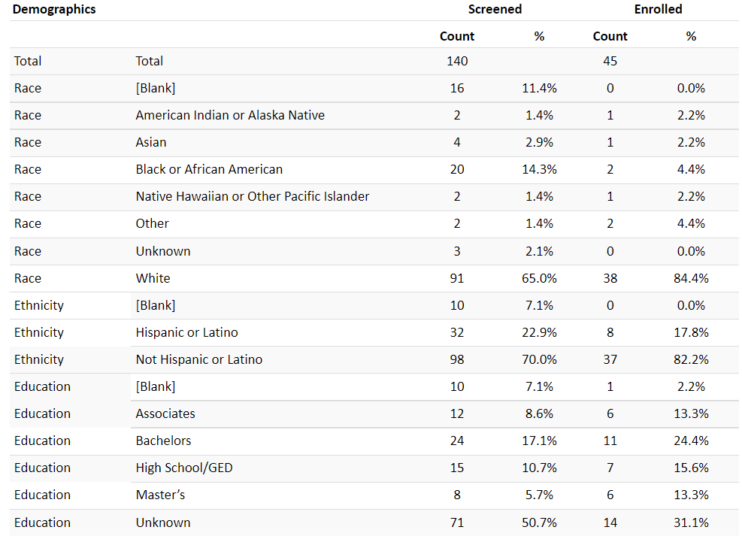
Demographics

Slide 8
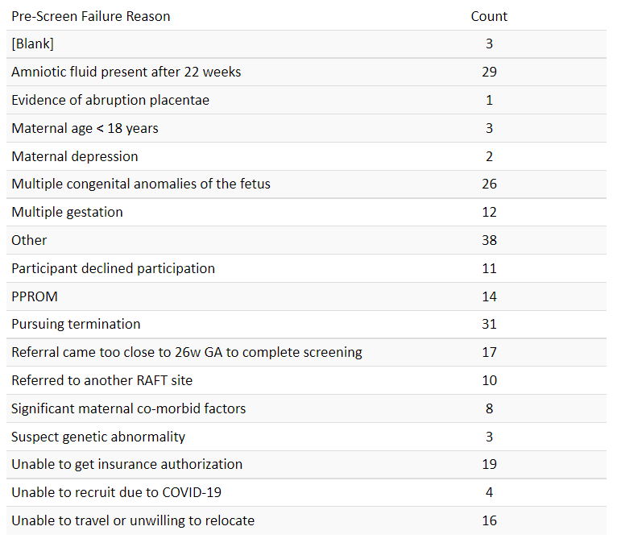
Pre-Screen Failure Primary Reasons

Slide 9
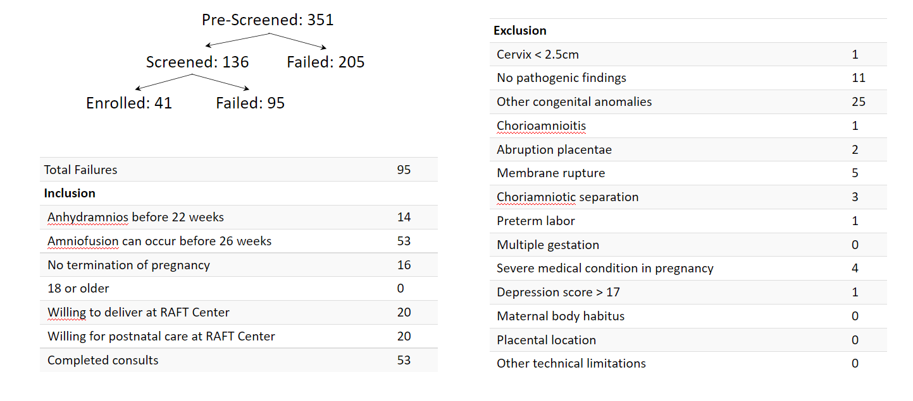
Screen Failure

Slide 10
Protocol Deviations and Adverse Events

Slide 11
Queries

Slide 12
New Sites Update
4 additional sites

Slide 13
Registry Progress

Slide 14
Manuscript Update
JAMA returned manuscript with recommended edits

Slide 15
NAFTNET 2023
Thursday, October 19th
Agenda

Slide 16
Questions?
Next Meeting: October 19, 2023 during NAFTNET

