Slide 1

RAFT Monthly All-Sites
October 19, 2023, 1-2pm EST

Slide 2
RAFT Trial Timeline
NICHD
funding
March 2021-February 2022
March 2023-February 2024
We are here
March 2020-February 2021
March 2022- February 2023
March 2024-February 2025
All 9 sites activated as of August 2021

Slide 3
Enrollment Report

Slide 4
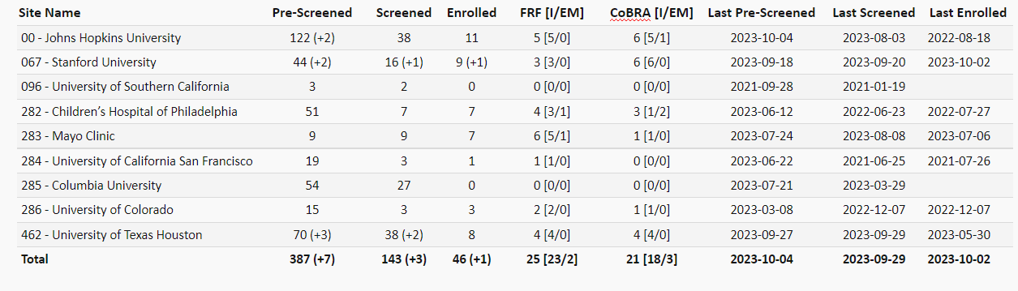
RAFT Prescreen, Screen & Enrollment Report
Data is as of October 10, 2023
Numbers in parentheses indicate changes since last report date September 12, 2023
* USC enrolled one participant, who is transferred to Stanford.

Slide 5
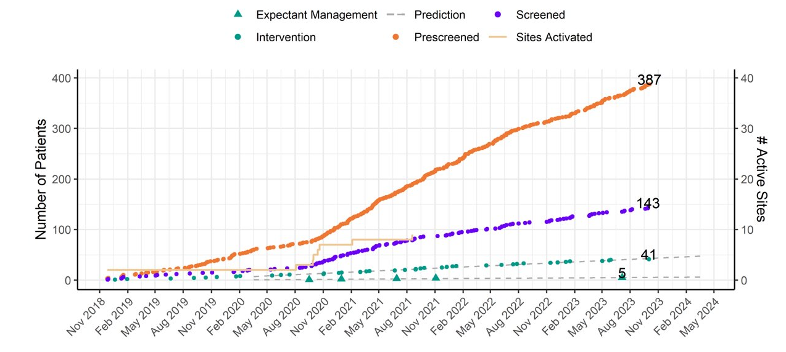
RAFT Prescreen, Screening and Enrollment Over Time

Slide 6
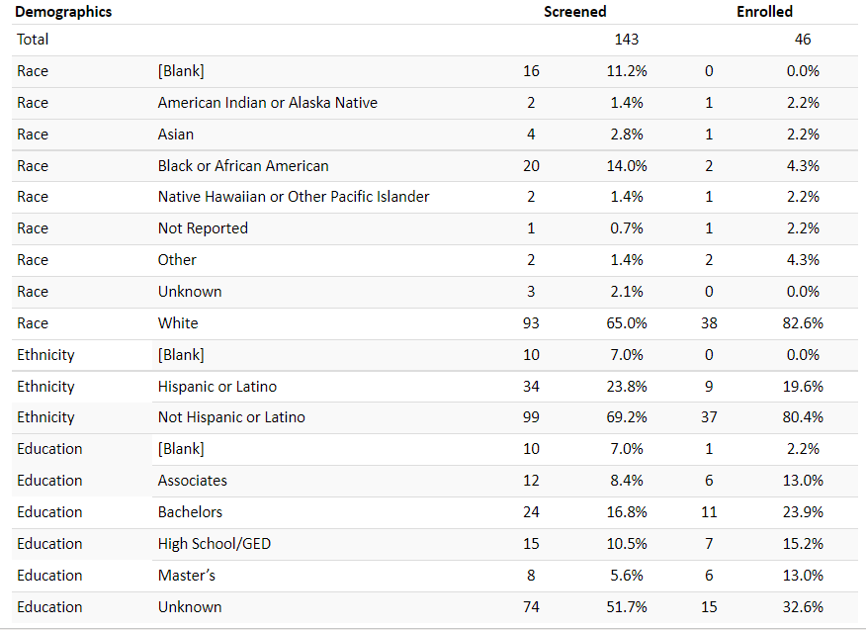
Demographics

Slide 7
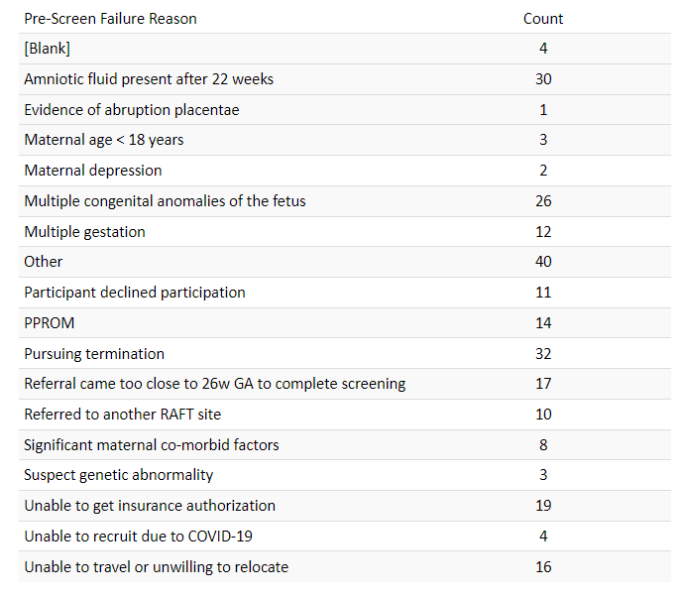
Pre-Screen Failure Primary Reasons

Slide 8
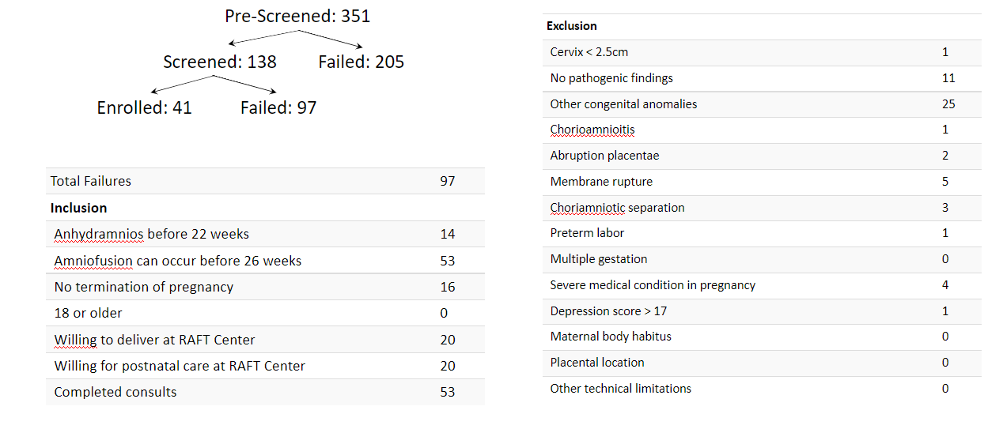
Screen Failure

Slide 9
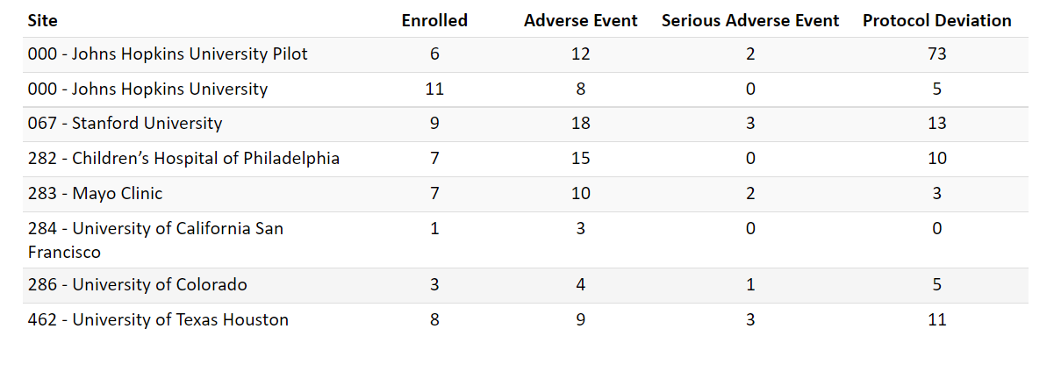
Protocol Deviations and Adverse Events

Slide 10
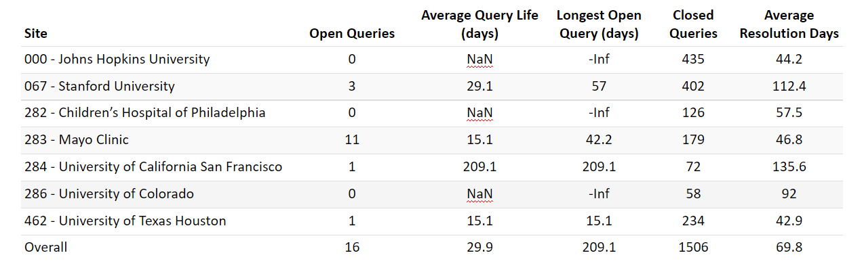
Queries

Slide 11
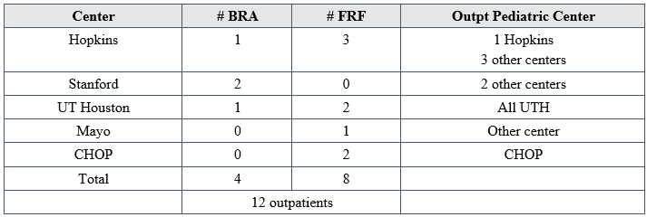
Pediatric outpatients
Age range 11 months - 4 years
10 on chronic PD, 1 on chronic HD, one left NICU without dialysis

Slide 12
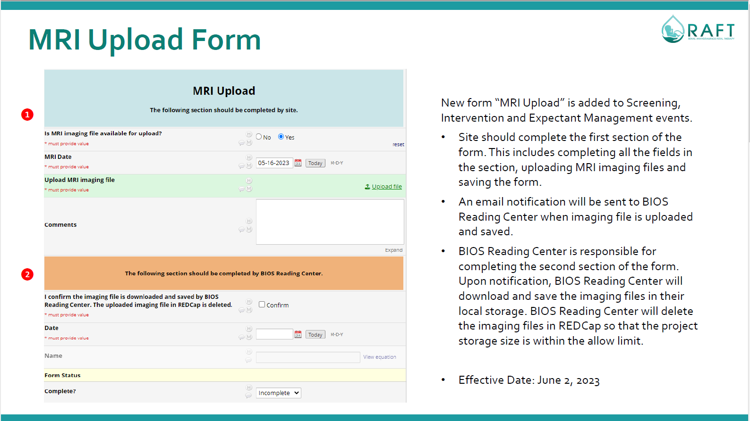

Slide 13
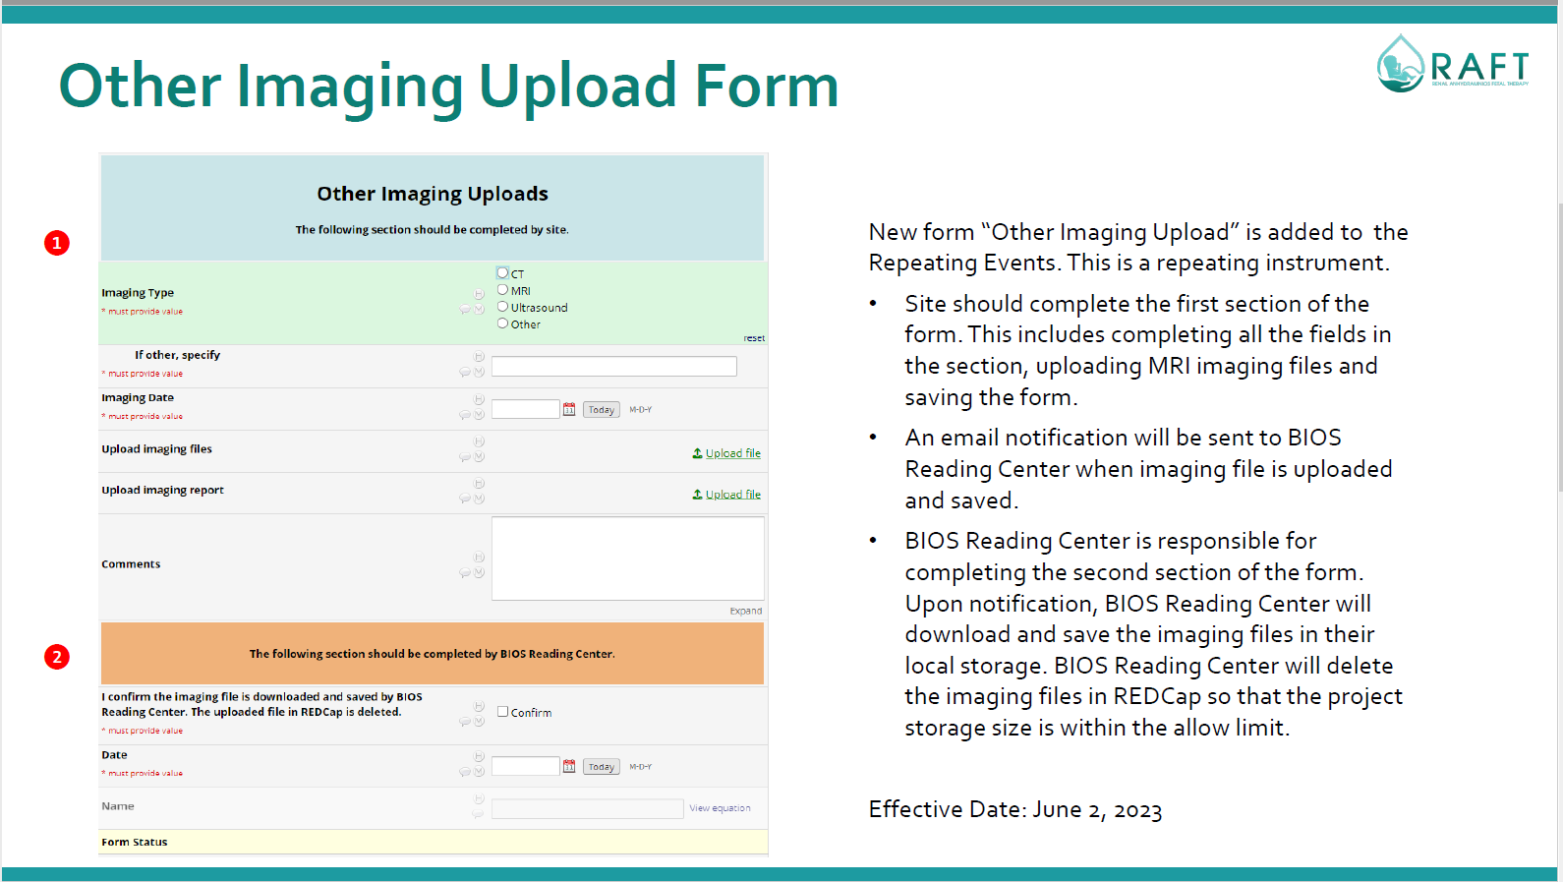

Slide 14
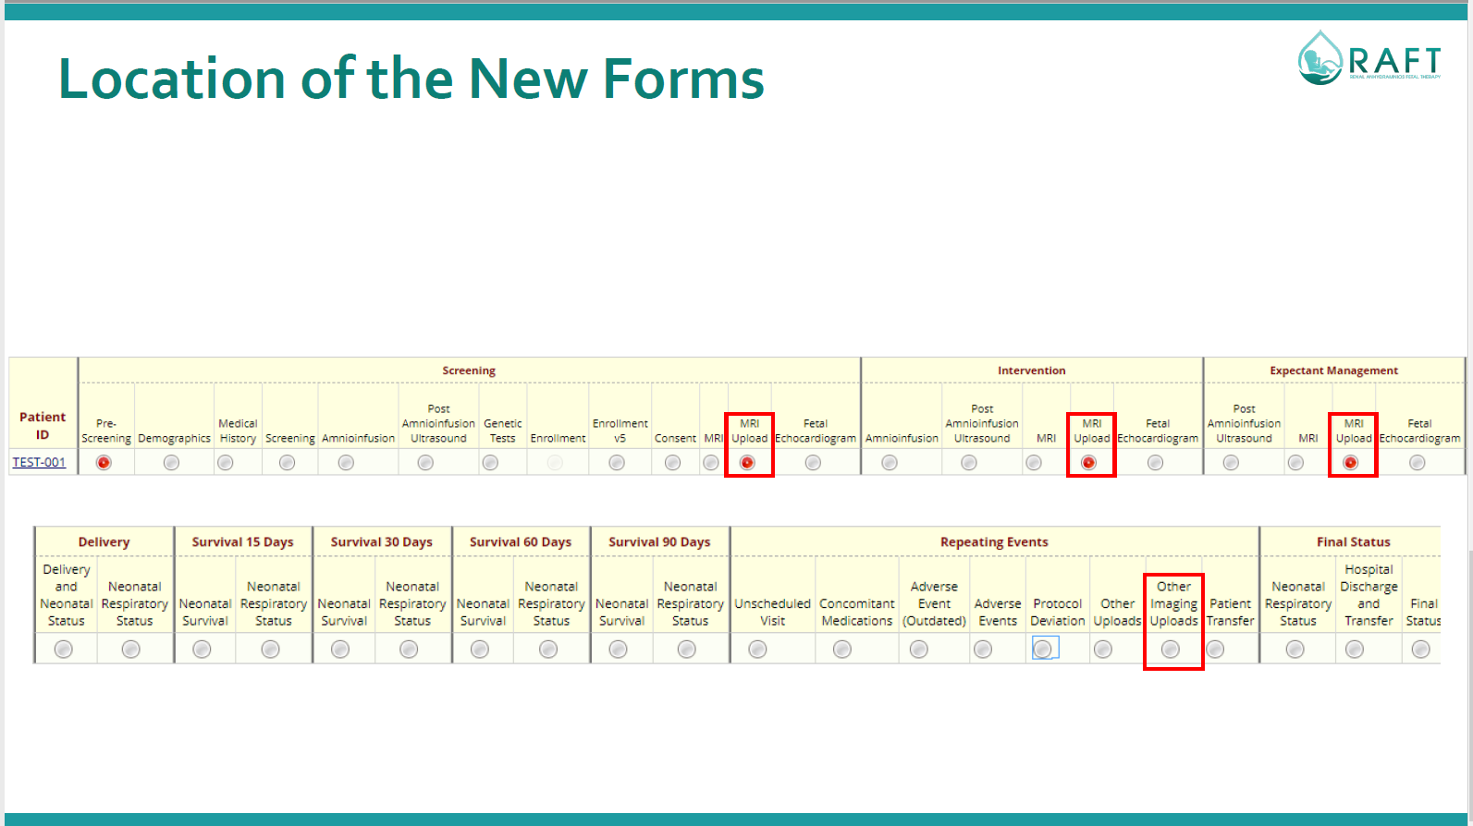

Slide 15
Questions?
Next Meeting: November 20, 2023

