Slide 1

RAFT Monthly All-Sites
November 20, 2023, 10-11am EST

Slide 2
Agenda
New Sites Onboarding
Enrollment Report
Manuscript Updates
Registry/TIN Progress
Central Verification Prompt
Fetal MRI Imaging Upload for Lung Assessment
Presentation from Dr. Hendriks

Slide 3
New Sites Update
Welcome
  Boston Children’s Hospital
  Washington University in St. Louis
  Baylor/Texas Children’s Hospital
Currently in Onboarding process

Slide 4
RAFT Trial Timeline
NICHD
funding
March 2021-February 2022
March 2023-February 2024
We are here
March 2020-February 2021
March 2022- February 2023
March 2024-February 2025
All 9 sites activated as of August 2021

Slide 5
Enrollment Report

Slide 6
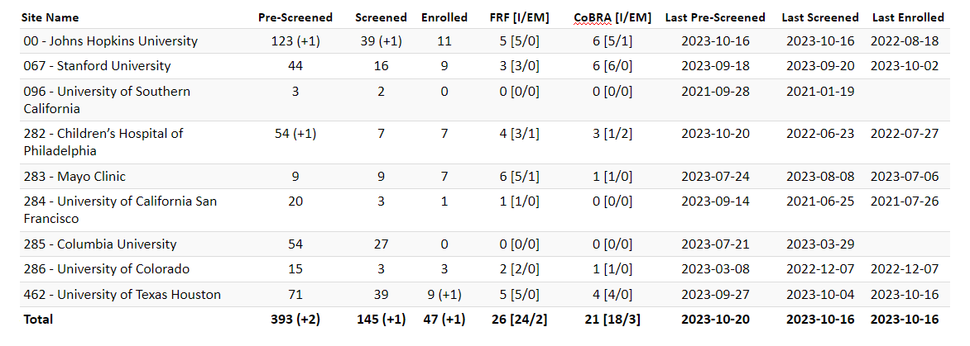
RAFT Prescreen, Screen & Enrollment Report
Data is as of November 13, 2023
Numbers in parentheses indicate changes since last report date October 10, 2023
* USC enrolled one participant, who is transferred to Stanford.

Slide 7
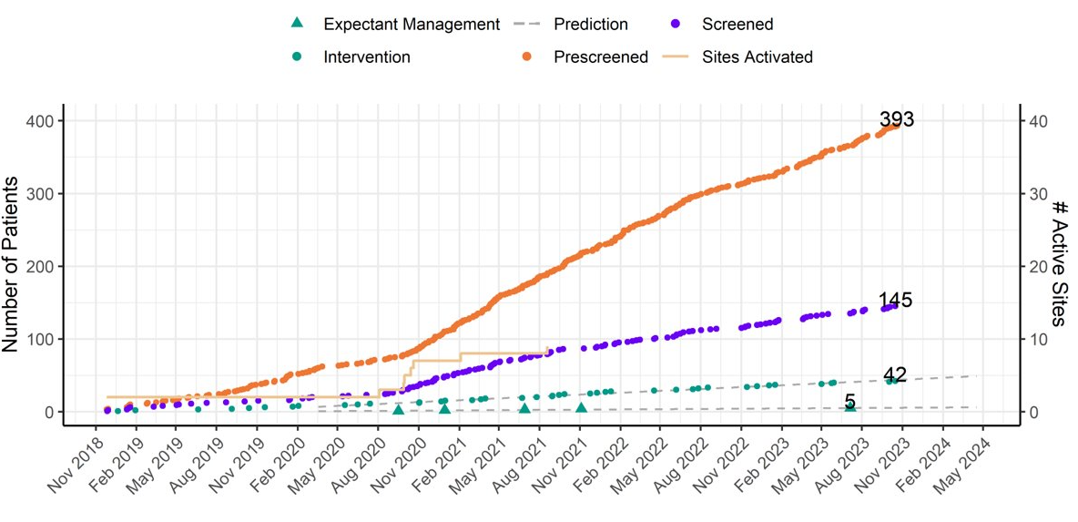
RAFT Prescreen, Screening and Enrollment Over Time

Slide 8
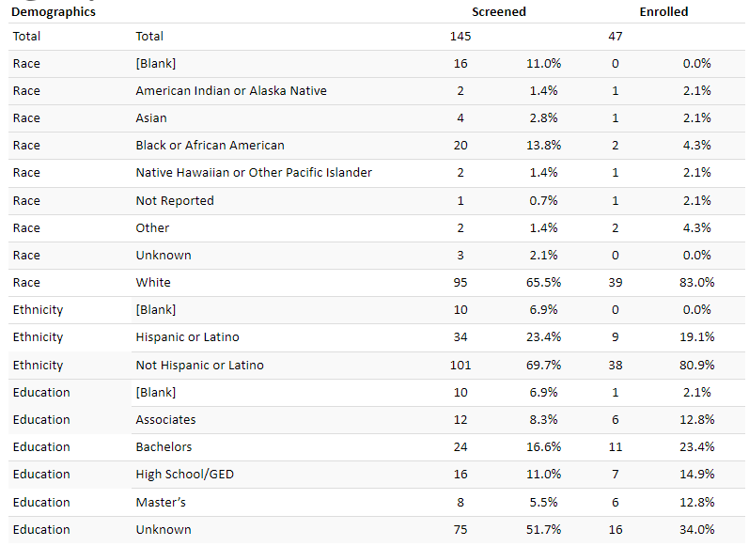
Demographics

Slide 9
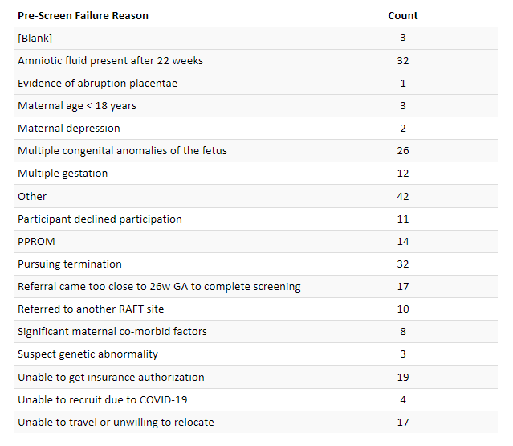
Pre-Screen Failure Primary Reasons

Slide 10
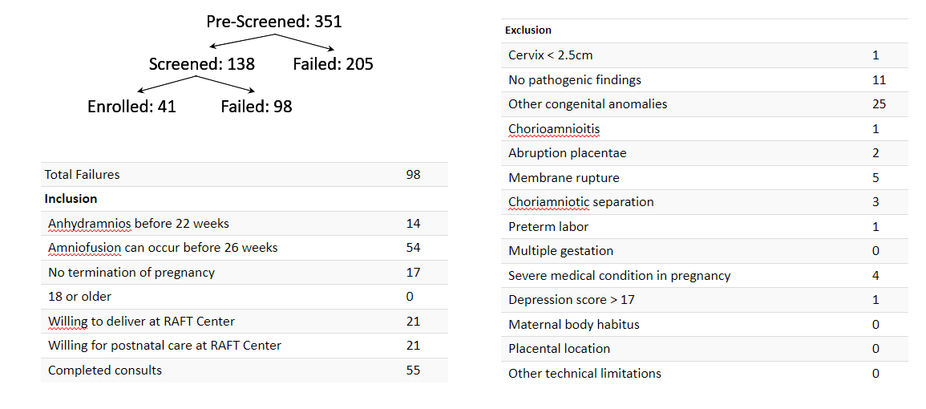
Screen Failure

Slide 11
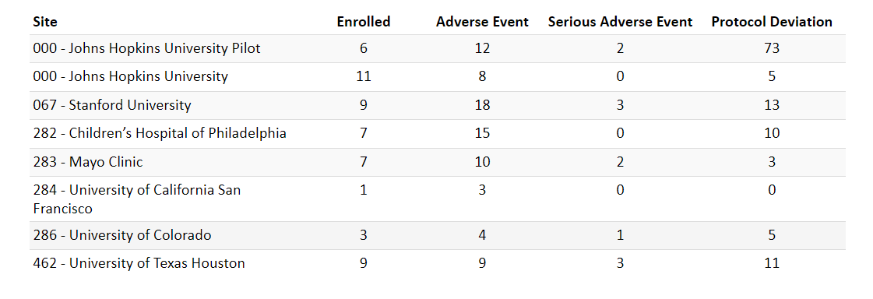
Protocol Deviations and Adverse Events

Slide 12
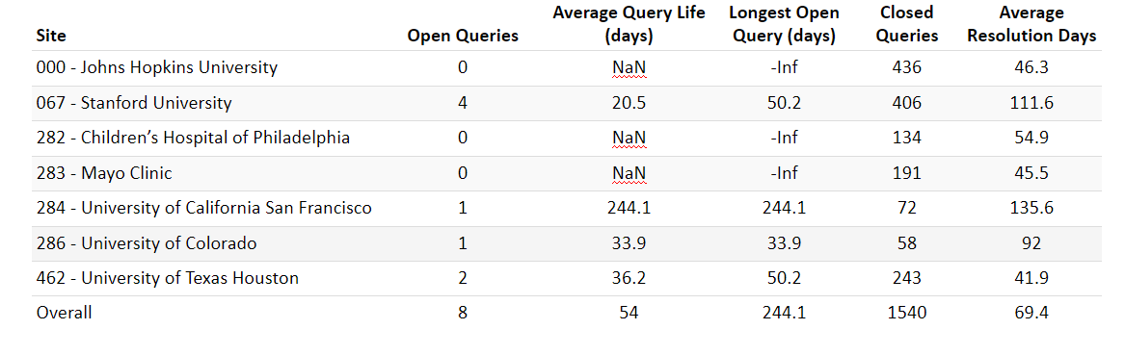
Queries

Slide 13
Manuscript Update
  CoBRA Manuscript
  Initial Management Survey
    Submitted to JAMA Peds

Slide 14
Registry/TIN Progress

Slide 15
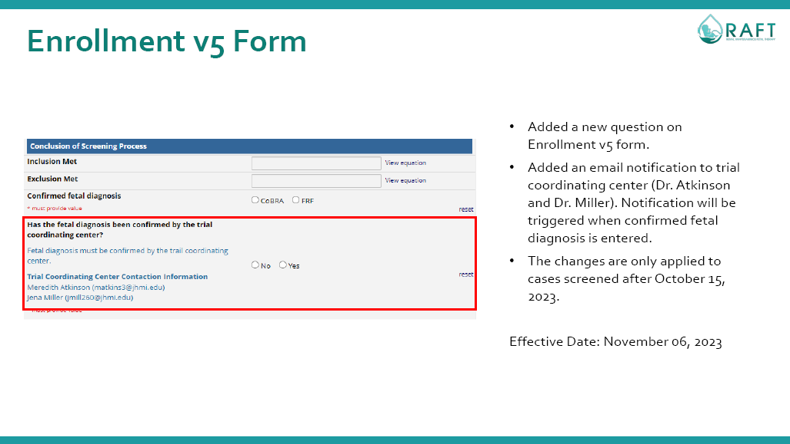
Central Verification Prompt

Slide 16
Fetal MRI Imaging Upload for Lung Assessment

Slide 17
Dr. Hendriks Presentation

Slide 18
Questions?
Next Meeting: December 18, 2023

