Slide 1

RAFT Monthly All-Sites
January 22, 2024, 10-11am EST

Slide 2
Agenda
Enrollment Report
Site Updates
CIR: RAFT Protocol v7.0 and Master Consent changes
Prenatal counseling, consent, and neonatal outcomes
Registry/TIN Progress

Slide 3
RAFT Trial Timeline
NICHD
funding
March 2021-February 2022
March 2023-February 2024
We are here
March 2020-February 2021
March 2022- February 2023
March 2024-February 2025
All 9 sites activated as of August 2021

Slide 4
Enrollment Report

Slide 5
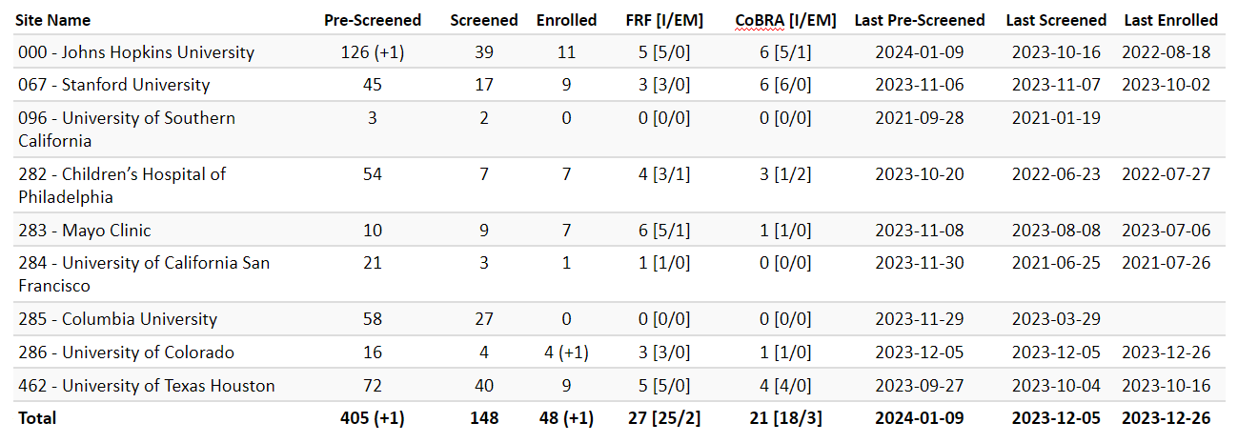
RAFT Prescreen, Screen & Enrollment Report
Data is as of January 8, 2024
Numbers in parentheses indicate changes since last report date December 11, 2023
* USC enrolled one participant, who is transferred to Stanford.

Slide 6
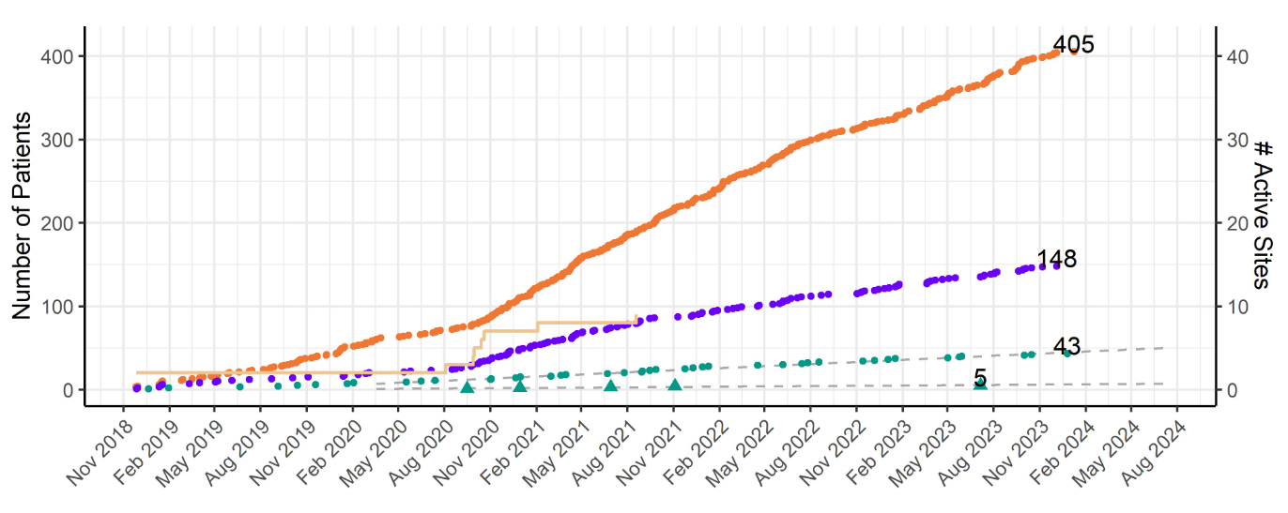
RAFT Prescreen, Screening and Enrollment Over Time

Slide 7
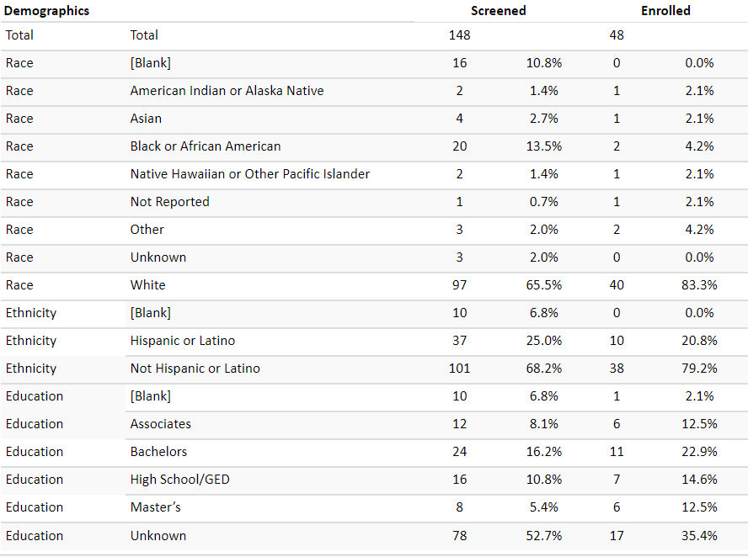
Demographics

Slide 8
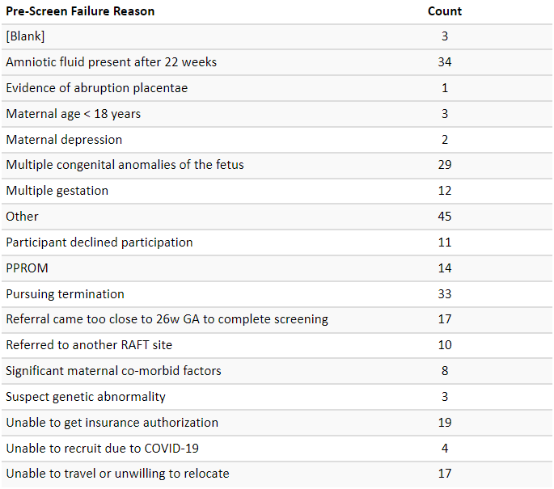
Pre-Screen Failure Primary Reasons

Slide 9
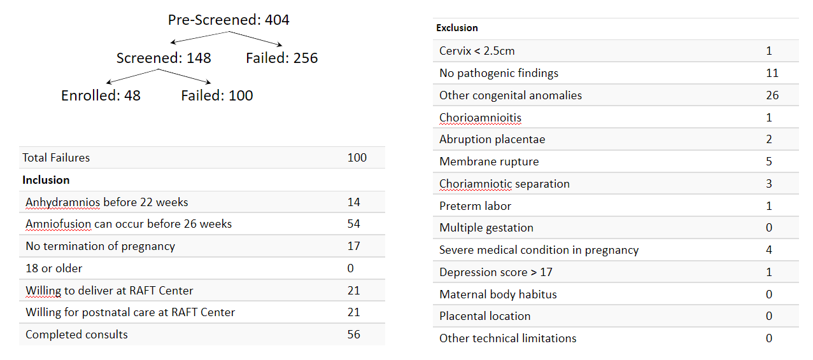
Screen Failure

Slide 10
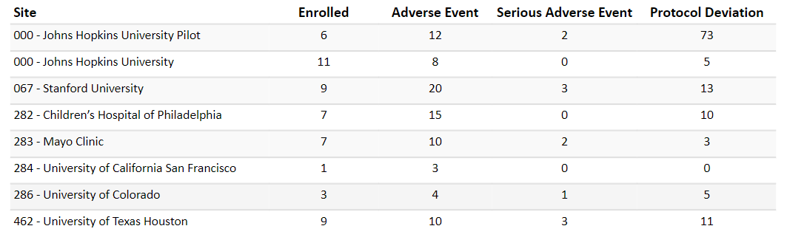
Protocol Deviations and Adverse Events

Slide 11
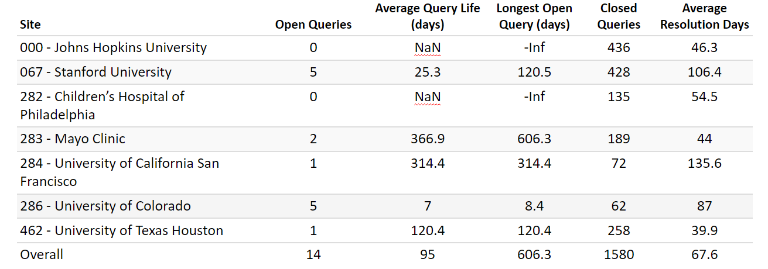
Queries

Slide 12
Site Updates
Boston Children’s fully activated

Slide 13
Transplant Milestone
2.5 yo enrolled at UT Houston transplanted in December 2023

Slide 14
Protocol v7.0 CIR
Emails today from Noeleen Ostapkovich summarizing changes

Slide 15
Master Consent
Adapting wording to “you have been offered information about termination”
Updated to reflect circumstances when dialysis might not be an option in neonates
Harmonized intervention and EM consents regarding potential neonatal mortality

Slide 16
Prenatal Counseling
Prenatal Consultations Required
  Neonatology
  Pediatric Nephrology
  Transplant Surgery
  Pediatric Surgery (dialysis access)
  Maternal Fetal Medicine
  Social Work
  Genetic Counselor

Slide 17
Registry/TIN Progress
TIN Consult held last week

Slide 18
Questions?
Next Meeting: February 26, 2024
  Look out for new meeting invite!

