Slide 1

RAFT Monthly All-Sites
February 26, 2024, 10-11am EST

Slide 2
Agenda
Enrollment Report
JAMA peds research later
Site Updates
Biospecimen Analysis protocol
Registry/TIN Progress

Slide 3
RAFT Trial Timeline
NICHD
funding
March 2021-February 2022
March 2023-February 2024
We are here
March 2020-February 2021
March 2022- February 2023
March 2024-February 2025
All 9 sites activated as of August 2021

Slide 4
Enrollment Report

Slide 5
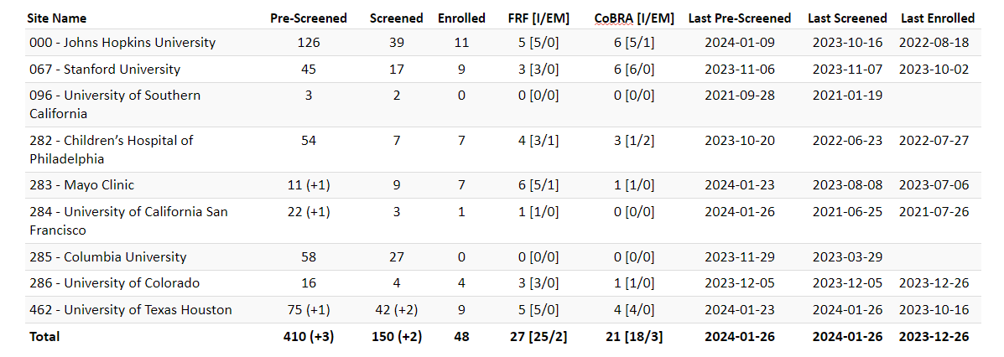
RAFT Prescreen, Screen & Enrollment Report
Data is as of February 12, 2024
Numbers in parentheses indicate changes since last report date January 22, 2024
* USC enrolled one participant, who is transferred to Stanford.

Slide 6
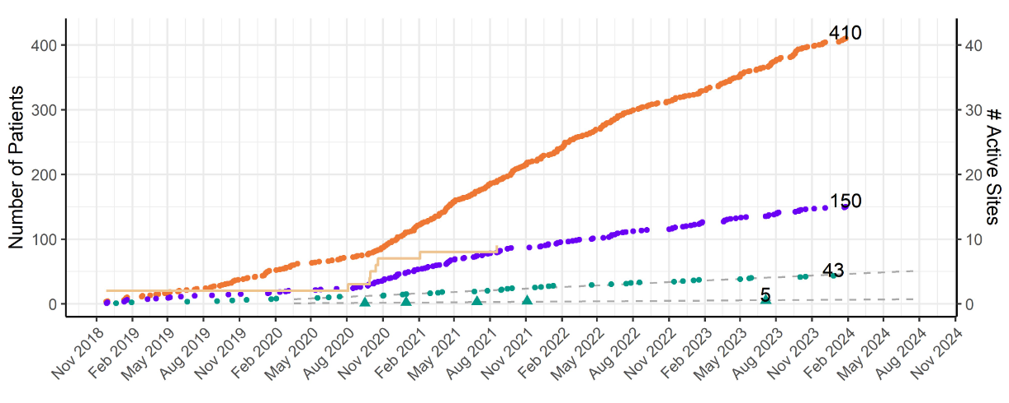
RAFT Prescreen, Screening and Enrollment Over Time

Slide 7
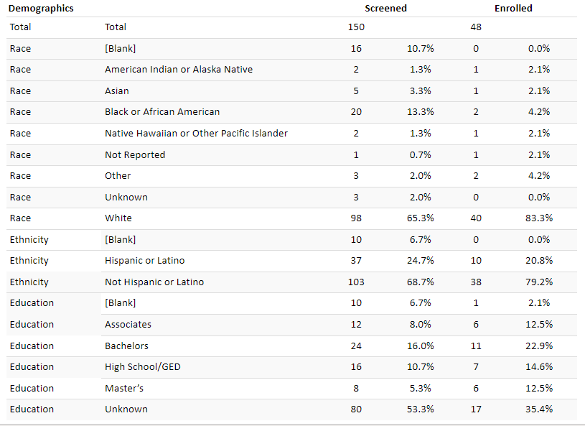
Demographics

Slide 8
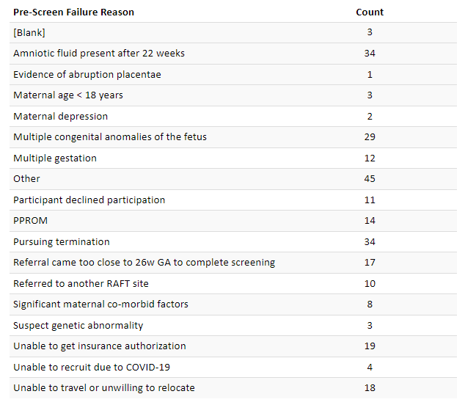
Pre-Screen Failure Primary Reasons

Slide 9
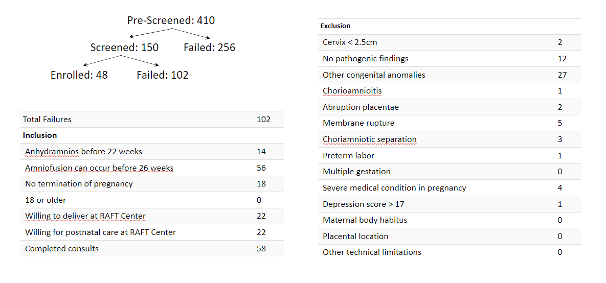
Screen Failure

Slide 10
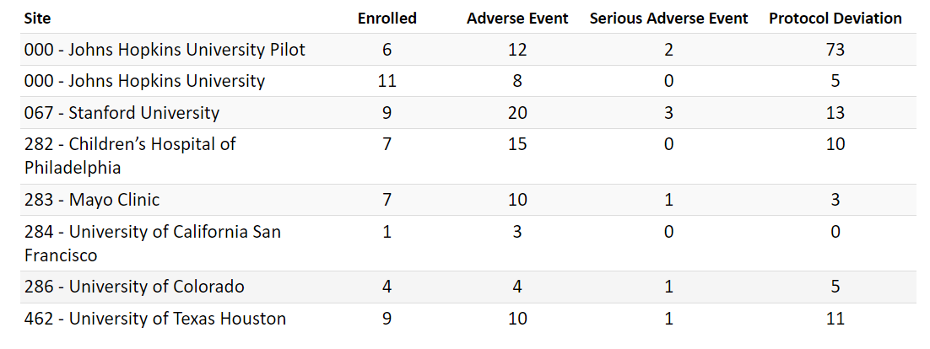
Protocol Deviations and Adverse Events

Slide 11
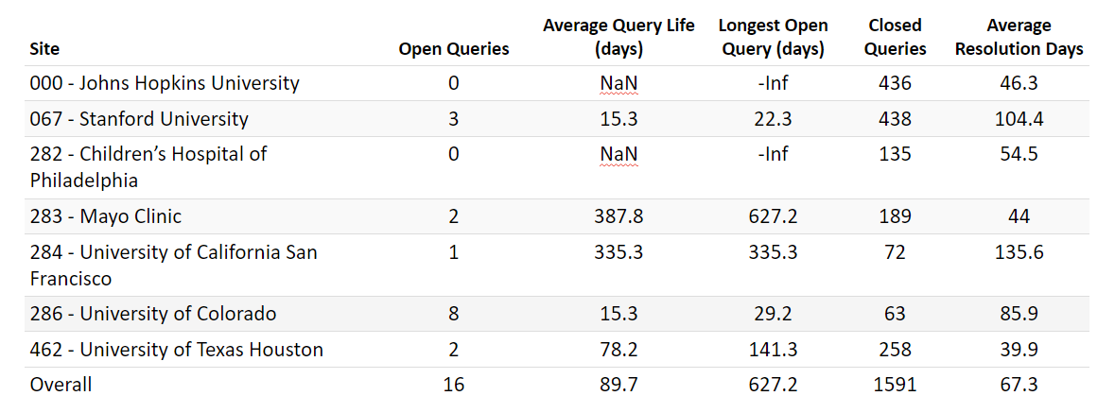
Queries

Slide 12
JAMA Peds Research Letter
Presentation from Dr. Ellen Bendel-Stenzel & Dr. Amaris Keiser

Slide 13
Site Updates

Slide 14
Biospecimen Analysis Protocol

Slide 15
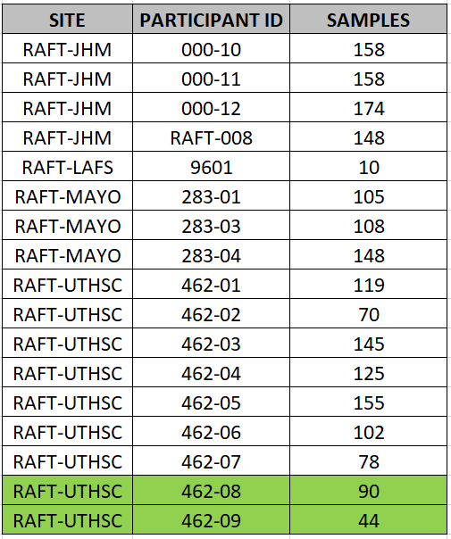
Sample Shipment Update
Notes:
*green represents new shipments received since last summer
Sites that need to ship- Colorado, Stanford, CHOP, UCSF

Slide 16
Registry/TIN Progress
Next TIN Meeting- February 27th

Slide 17
Questions?
Next Meeting: March 18, 2024

