Slide 1
RAFT Echo Protocol
Ver 07.27.2020

Slide 2
Echo in the RAFT Trial
All patients will have a standard fetal echocardiogram at the time of enrollment (clinical care)
Enrolled patients will have a study echocardiogram with maternal hyperoxia in the third trimester
All echocardiograms will be read in a core lab. Studies therefore must be anonymized and uploaded to a central server. We have contracted with Tricefy to perform this service.

Slide 3
Echo in the RAFT Trial
Study echo assessments noted below should be obtained in 2 states
  At rest (baseline) with the mother in room air
  With maternal hyperoxygenation. achieved by administration of 100% FiO2 via non-rebreather at 8L/min to the mother 10 minutes prior to the initiation of imaging
Important notes:
  States must be labeled on-screen as:
    “Rest”
    “Hyperoxia”
  All measurements will be made by the core lab
  Onscreen measurements are discouraged unless otherwise noted

Slide 4
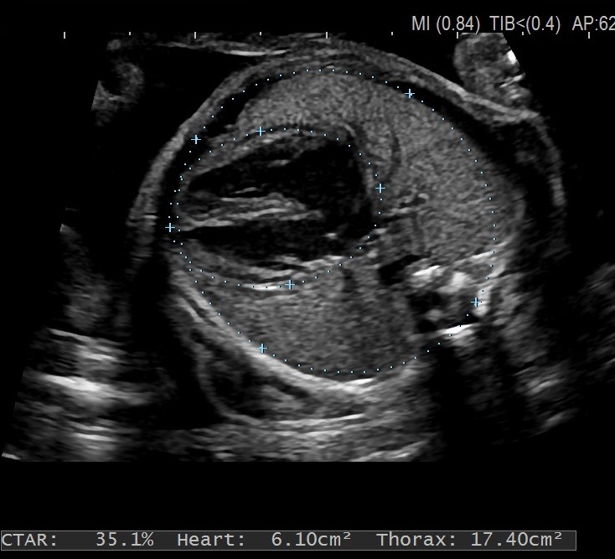
Biometry (optional for echo)
Biometric measurements: (estimated fetal weight, biparietal diameter, femur length, and head circumference, measurement on image)
The following cardiac specific measurements will be made: *Fetal CTR from axial chest view, cine clip, with and without color Doppler

Slide 5
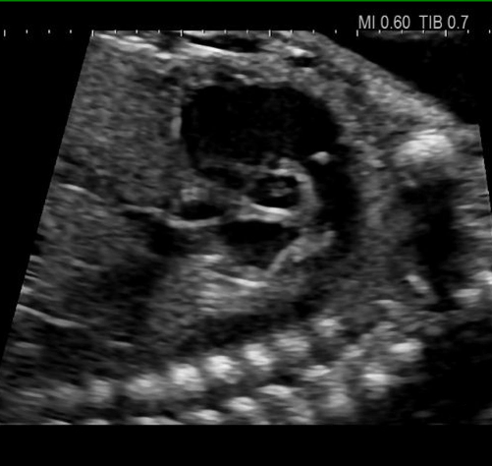
2-dimensional (2D) images of the following vessels/valves
1. Pulmonary valve (PV) short-axis
2. Aortic valve (AV) long-axis
3. Mitral valve (MV) 4-chamber
4. Tricuspid valve (TV) 4-chamber
5. Branch pulmonary arteries, left and right
6. *#TAPSE
7. Short-axis cine clip of ventricles at LV pap muscles

Slide 6
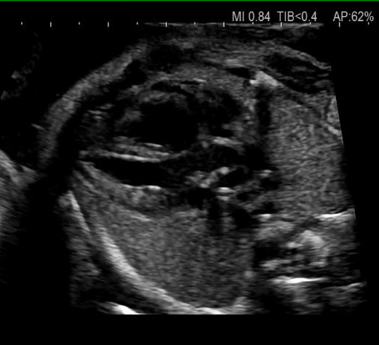
2-dimensional (2D) images of the following vessels/valves
1. Pulmonary valve (PV) short-axis
2. Aortic valve (AV) long-axis
3. Mitral valve (MV) 4-chamber
4. Tricuspid valve (TV) 4-chamber
5. Branch pulmonary arteries, left and right
6. *#TAPSE
7. Short-axis cine clip of ventricles at LV pap muscles

Slide 7
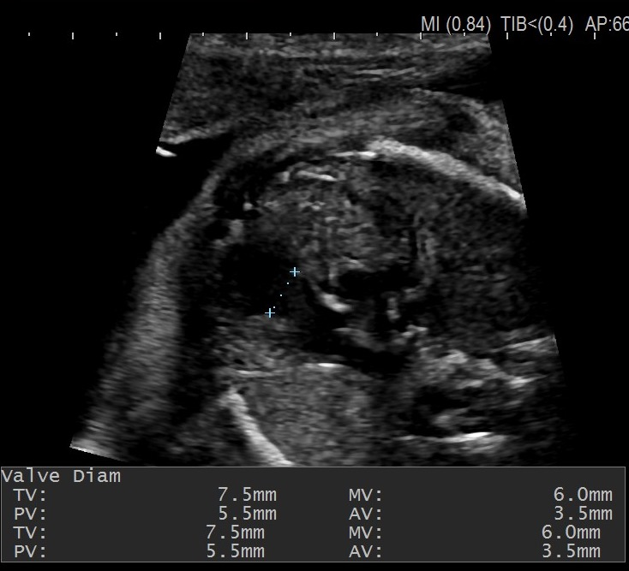
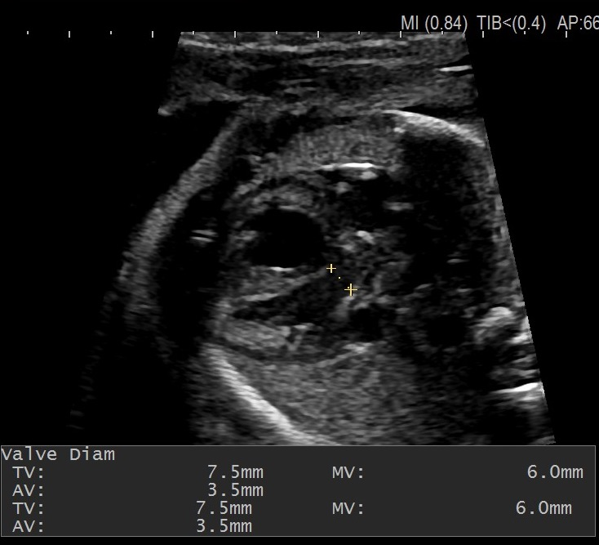
2-dimensional (2D) images of the following vessels/valves
1. Pulmonary valve (PV) short-axis
2. Aortic valve (AV) long-axis
3. Mitral valve (MV) 4-chamber
4. Tricuspid valve (TV) 4-chamber
5. Branch pulmonary arteries, left and right
6. *#TAPSE
7. Short-axis cine clip of ventricles at LV pap muscles

Slide 8
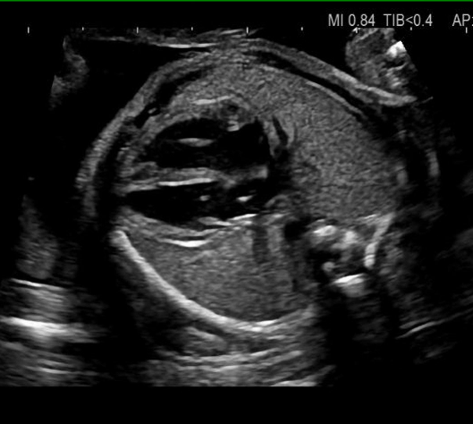
2-dimensional (2D) images of the following vessels/valves
1. Pulmonary valve (PV) short-axis
2. Aortic valve (AV) long-axis
3. Mitral valve (MV) 4-chamber
4. Tricuspid valve (TV) 4-chamber
5. Branch pulmonary arteries, left and right
6. *#TAPSE
7. Short-axis cine clip of ventricles at LV pap muscles

Slide 9
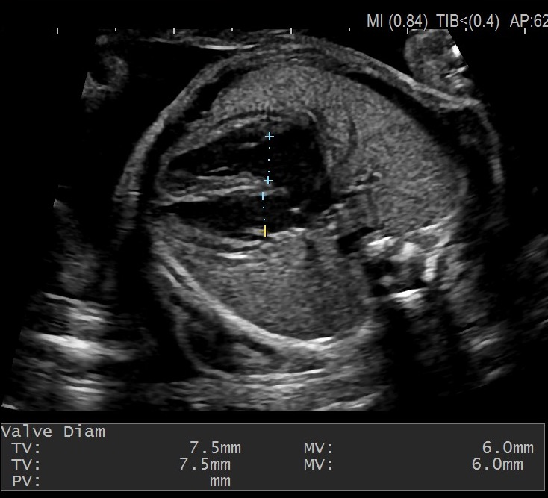
2-dimensional (2D) images of the following vessels/valves
1. Pulmonary valve (PV) short-axis
2. Aortic valve (AV) long-axis
3. Mitral valve (MV) 4-chamber
4. Tricuspid valve (TV) 4-chamber
5. Branch pulmonary arteries, left and right
6. *#TAPSE
7. Short-axis cine clip of ventricles at LV pap muscles

Slide 10
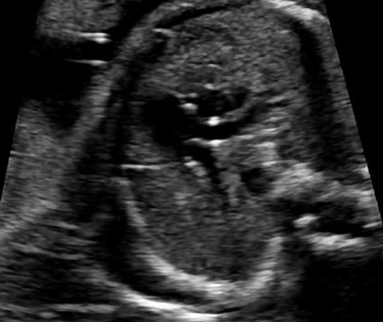
2-dimensional (2D) images of the following vessels/valves
1. Pulmonary valve (PV) short-axis
2. Aortic valve (AV) long-axis
3. Mitral valve (MV) 4-chamber
4. Tricuspid valve (TV) 4-chamber
5. Branch pulmonary arteries, left and right
6. *#TAPSE
7. Short-axis cine clip of ventricles at LV pap muscles

Slide 11
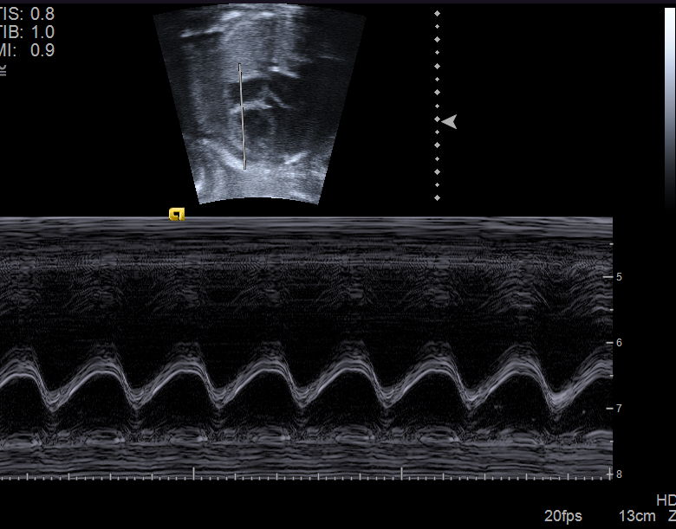
2-dimensional (2D) images of the following vessels/valves
1. Pulmonary valve (PV) short-axis
2. Aortic valve (AV) long-axis
3. Mitral valve (MV) 4-chamber
4. Tricuspid valve (TV) 4-chamber
5. Branch pulmonary arteries, left and right
6. *#TAPSE
7. Short-axis cine clip of ventricles at LV pap muscles

Slide 12
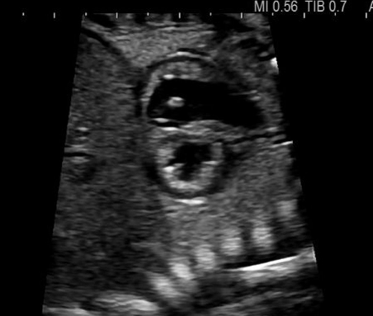
2-dimensional (2D) images of the following vessels/valves
1. Pulmonary valve (PV) short-axis
2. Aortic valve (AV) long-axis
3. Mitral valve (MV) 4-chamber
4. Tricuspid valve (TV) 4-chamber
5. Branch pulmonary arteries, left and right
6. *#TAPSE
7. Short-axis cine clip of ventricles at LV pap muscles

Slide 13
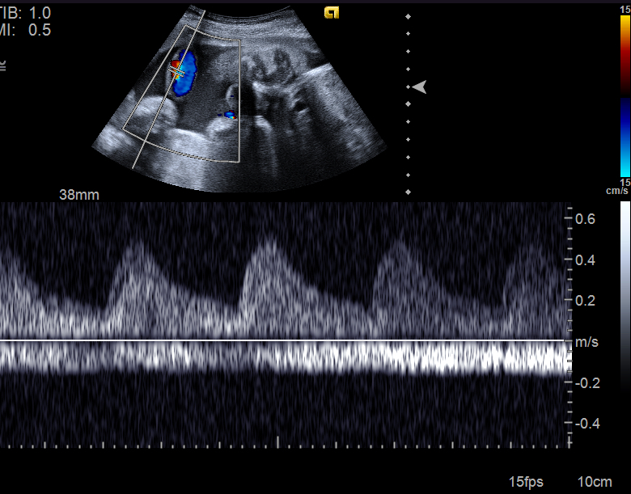
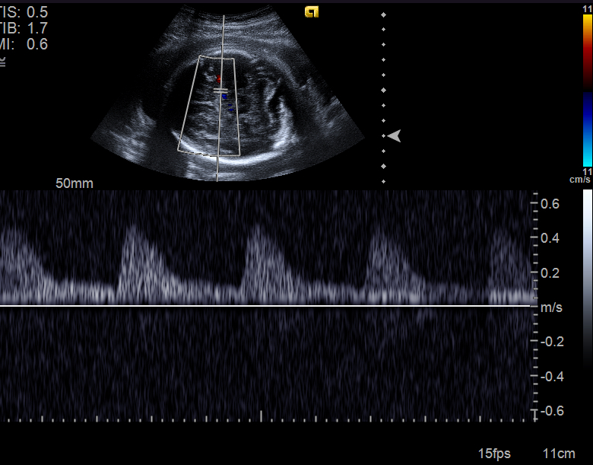
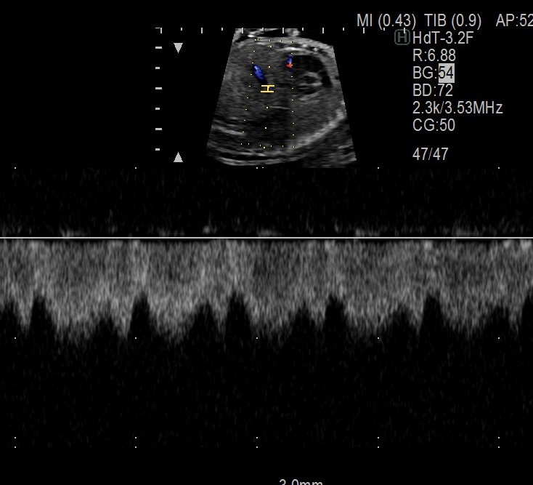
Doppler trace of the following vessels/valves (at least 3 beats, during fetal apnea):
1. *Umbilical artery (UA) at the cord insertion
2. *Umbilical vein (UV) at the cord insertion
3. *Middle cerebral artery (MCA) up side
4. *Ductus venosus (DV)
5. *Tricuspid and mitral valve inflow (and TR if present)
6. *Pulmonary valve
7. *Aortic valve
8. *LV-Ao Doppler with valve clicks visible
9. *branch pulmonary artery (same vessel for baseline and MH)
10.*#Ductus arteriosus distal at aortic end
11.*Pulmonary veins (one from each side)
repeated during MH(*) and recovery(#

Slide 14
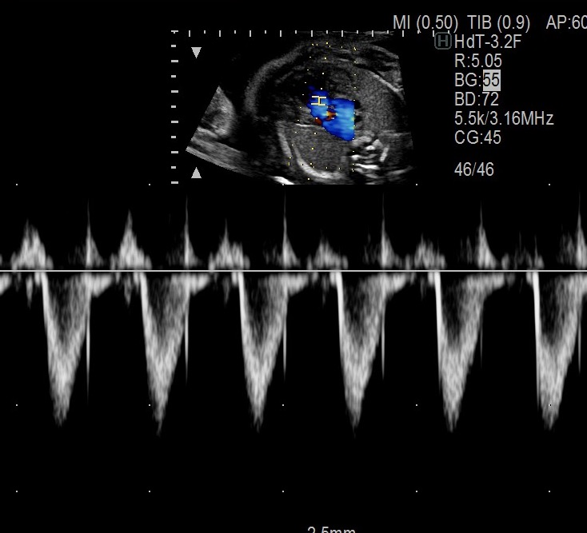
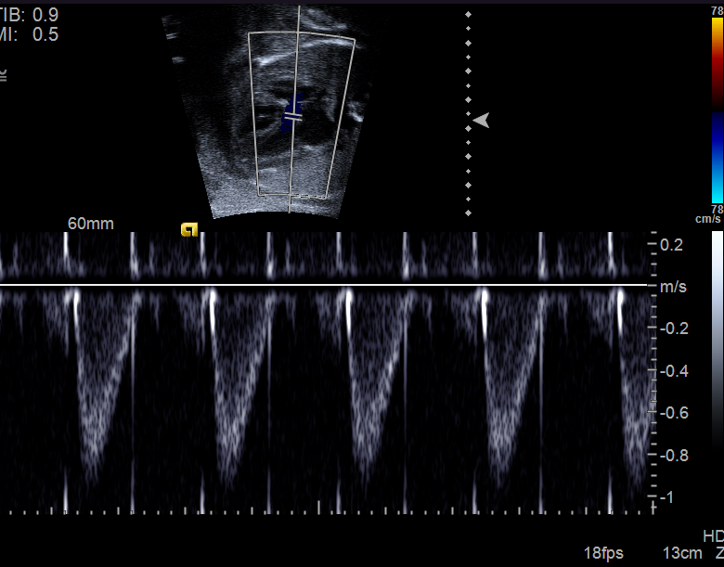
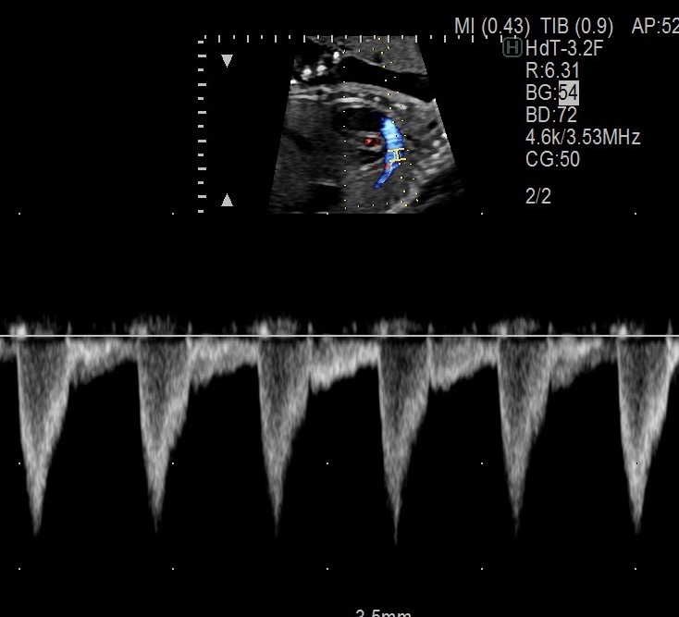
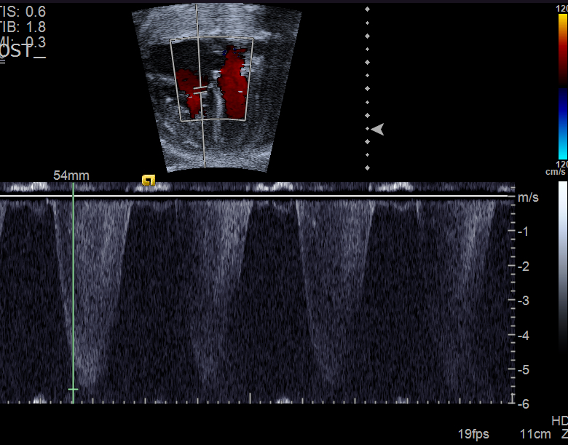
Doppler trace of the following vessels/valves (at least 3 beats, during fetal apnea):
1. *Umbilical artery (UA) at the cord insertion
2. *Umbilical vein (UV) at the cord insertion
3. *Middle cerebral artery (MCA) up side
4. *Ductus venosus (DV)
5. *Tricuspid and mitral valve inflow (and TR if present)
6. *Pulmonary valve
7. *Aortic valve
8. *LV-Ao Doppler with valve clicks visible
9. *branch pulmonary artery (same vessel for baseline and MH)
10.*#Ductus arteriosus distal at aortic end
11.*Pulmonary veins (one from each side)
repeated during MH(*) and recovery(#

Slide 15
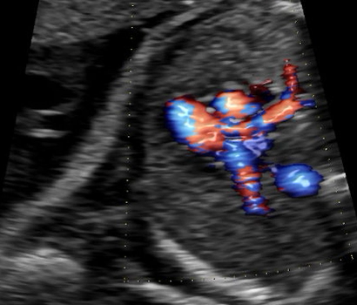
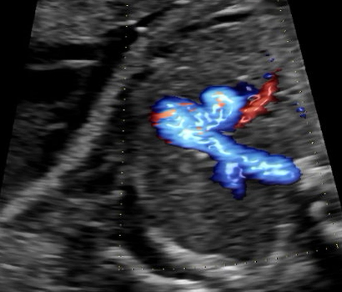
Pulmonary artery assessment
Diameter
Color flow
Branch PA Doppler
Pulmonary venous Doppler
Change in pulsatility with MH

Slide 16
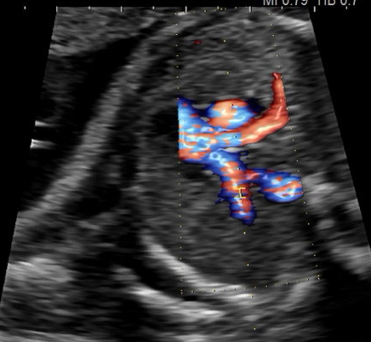
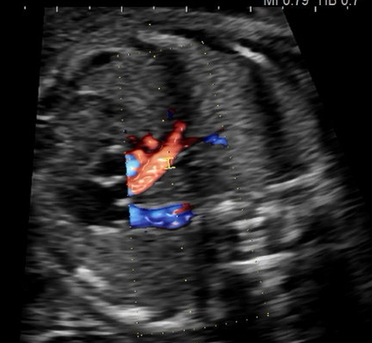
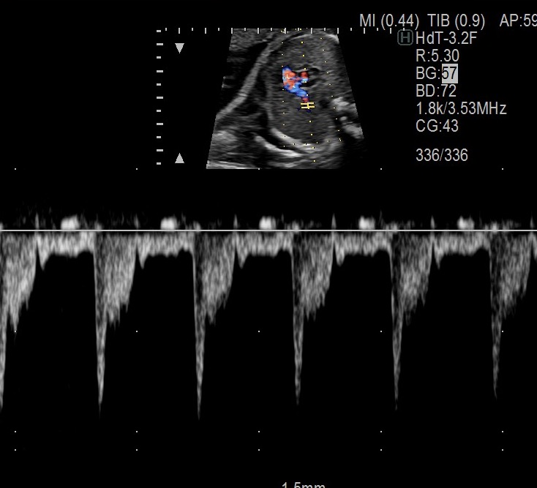
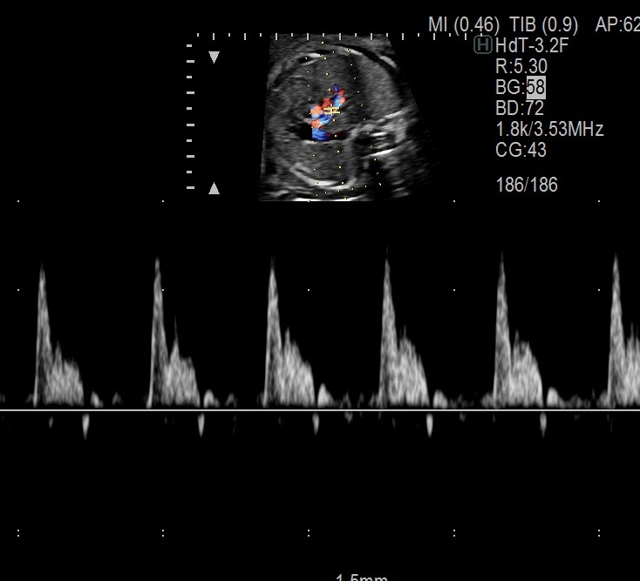
Pulmonary artery assessment
Diameter
Color flow
Branch PA Doppler
Pulmonary venous Doppler
Change in pulsatility with MH

Slide 17
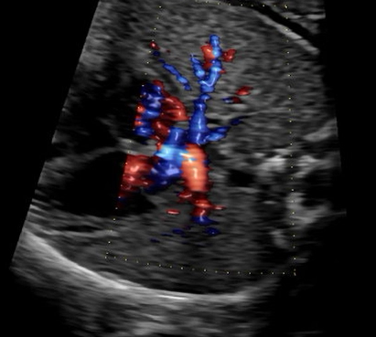
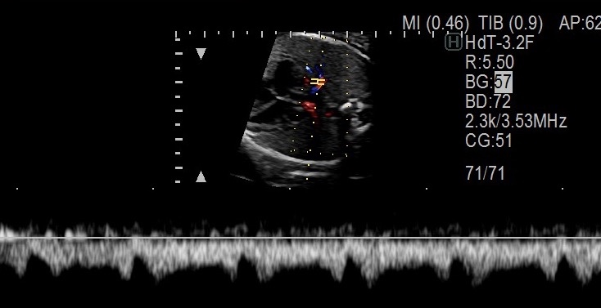
Pulmonary artery assessment
Diameter
Color flow
Branch PA Doppler
Pulmonary venous Doppler
Change in pulsatility with MH

Slide 18
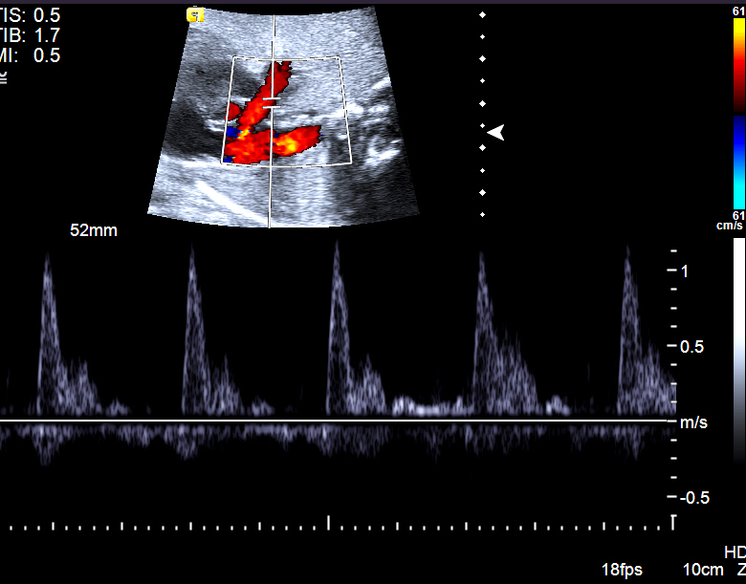
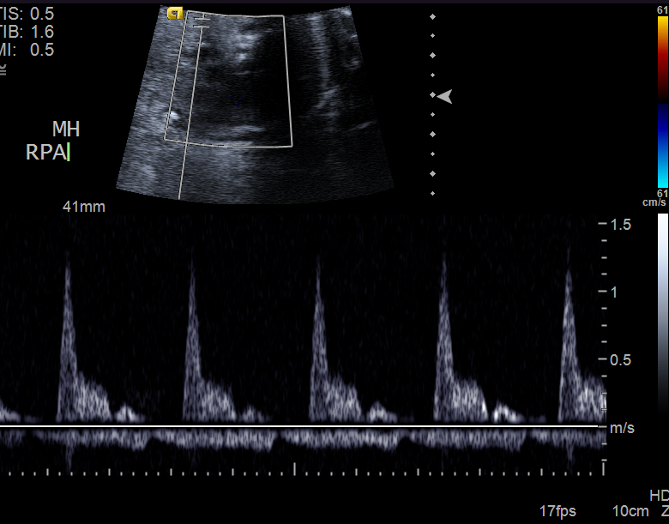
Pulmonary artery assessment
Diameter
Color flow
Branch PA Doppler
Pulmonary venous Doppler
Change in pulsatility with MH

Slide 19
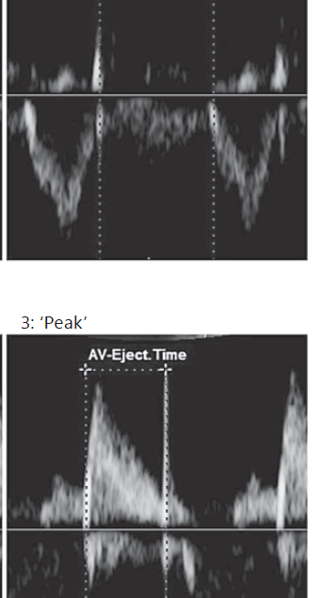
Please use the “peak” or middle of click method
Dopplers for time interval measurement, RV and LV
Time between inflows
Inflow duration
Ejection time
Meriki, Fetal Diagn Ther 2014;36:272–281

Slide 20
Dopplers for time interval measurement, RV and LV

Slide 21
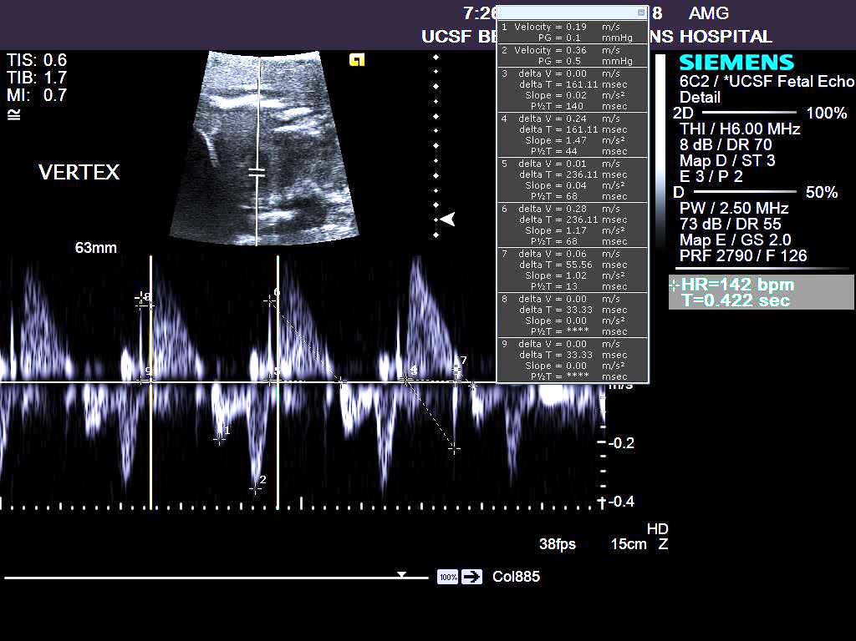
Dopplers for time interval measurement, RV and LV

Slide 22
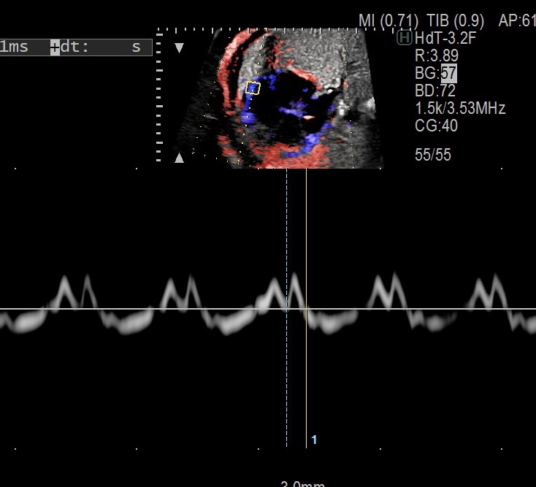
Tissue Doppler TV lateral annulus
Dopplers for time interval measurement, RV and LV

Slide 23
Sonographer Checklist
Biometry (abd, femur, head– only if these are already protocol in lab)
Axial 4ch 2D and color
LVOT/Aortic valve
3vv with branch PAs measurable, 2D
Sagittal sax ventricles 2D
Sagittal RVOT, pulmonary valve, ductal arch 2D
Dopplers: MCA, UA+UV, DV, AoV, PV, pulmonary veins, branch PAs, ductus arteriosus, inflows, LV-Ao in-out Doppler
TAPSE, TV DTI (lateral only)
Notes:
Assessments noted below should be obtained in 2 states
At rest (baseline) with the mother in room air
With maternal hyperoxygenation
Hyperoxia is achieved by administration of 100% FiO2 via non-rebreather at 8L/min to the mother 10 minutes prior to the initiation of imaging
Important notes:
States must be labeled on-screen as:
“Rest”
“Hyperoxia”
All measurements will be made by the core lab.
Onscreen measurements are discouraged
The following should be acquired:
Right pulmonary artery spectral Doppler sample
Right pulmonary artery should be samples at two points
Point 1: Distal to the PA bifurcation but proximal to RPA entrance into the lung parenchyma
Point 2: At the proximal portion of the RPA as it enters the lung parenchyma
Full-screen color Doppler images demonstrating the cursor position/sample volume for each spectral Doppler sample should be obtained
Aortic valve spectral Doppler sample
Pulmonary valve spectral Doppler sample
Right pulmonary vein spectral Doppler sample
Umbilical artery Doppler at cord insertion
Umbilical vein doppler
Middle cerebral artery Doppler
Ductus venosus Doppler
Right and left ventricular function

Slide 24
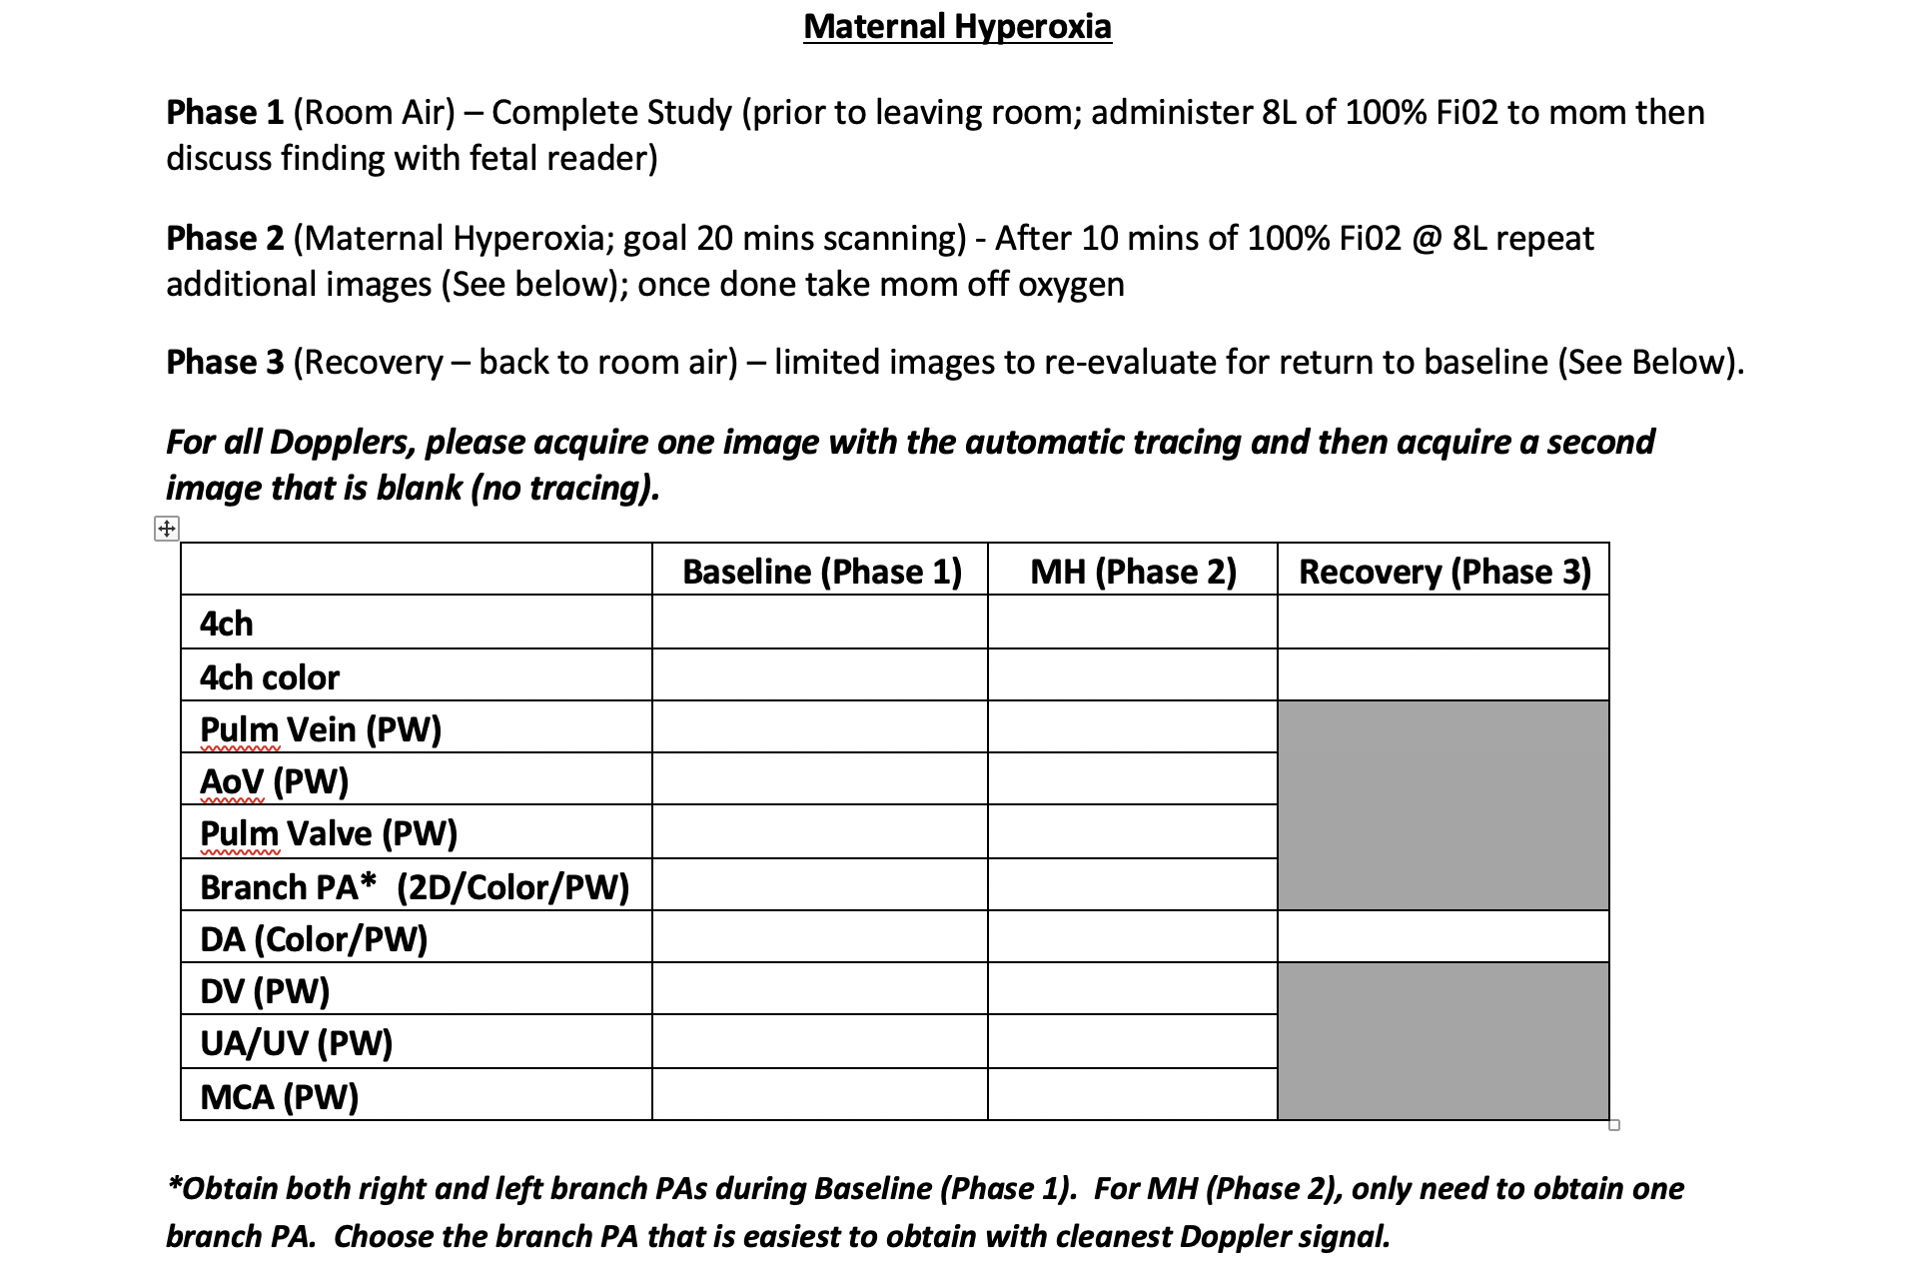
Cheat Sheet *Example*
& SAX
TAPSE and DTI, inflow PWs

Slide 25
Questions?
Anita.moongrady@ucsf.edu

